Slide 1
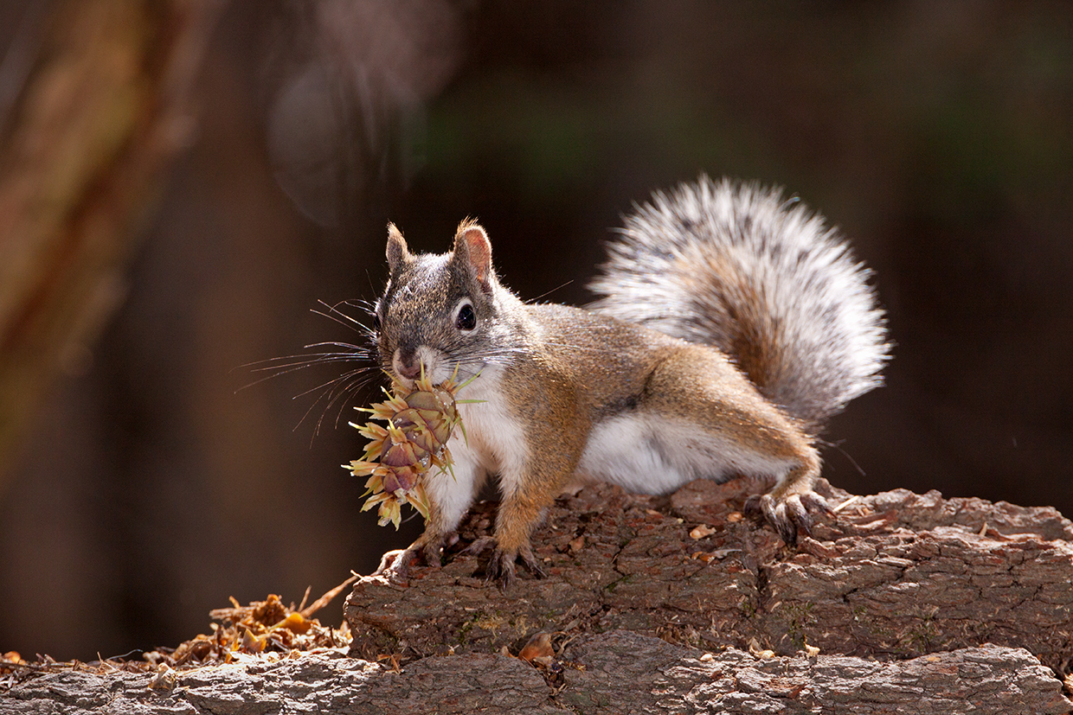
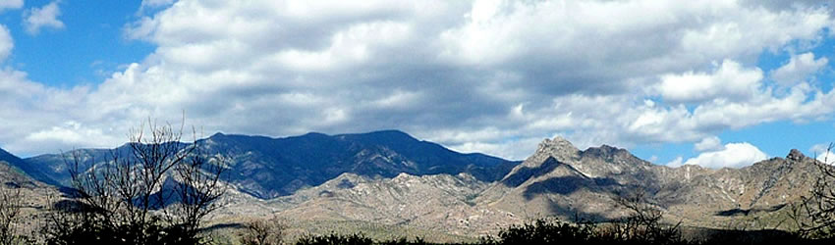
Potential for Climate Change induced extinction of the Sky Island Species Mount Graham Red Squirrel (Tamiasciurus hudsonicus grahamensis)
Eric Gibson, Bryan Runck
Mount Graham red squirrel (Tamiasciurus hudsonicus grahamensis)
Source: https://www.arizonahighways.com/sites/default/files/2023-08/0923_Nature.jpg
Pinaleño Mountains
Source: https://www.fs.usda.gov/wildflowers/beauty/Sky_Islands/Coronado_NF/PinalenoMountains/index.shtml

Slide 2
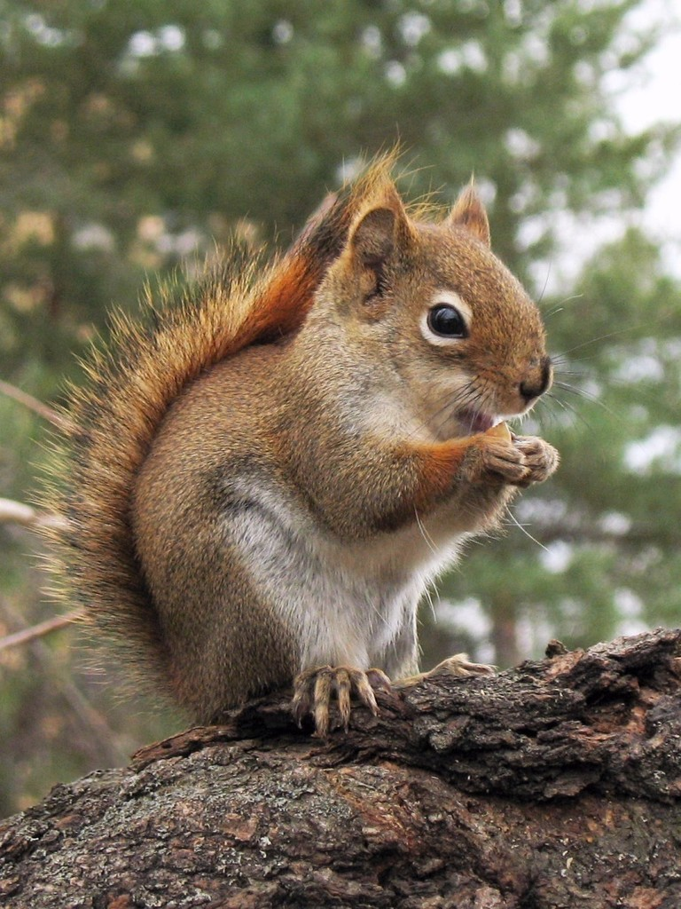
American Red Squirrel (Tamiasciurus hudsonicus) Facts
Range of offspring: 1 - 8
Average number of offspring: ~4
Year reaching maturity: 1 year
Percent of individuals who give birth every year: ~45%
Average lifespan: 5 years
Maximum recorded age: 10 years
Infant mortality: 75%
American red squirrel (Tamiasciurus hudsonicus)
Source: https://www.flickr.com/photos/gillesgonthier/2050894357
Sources: Murray 2000; Steele 1998

Slide 3
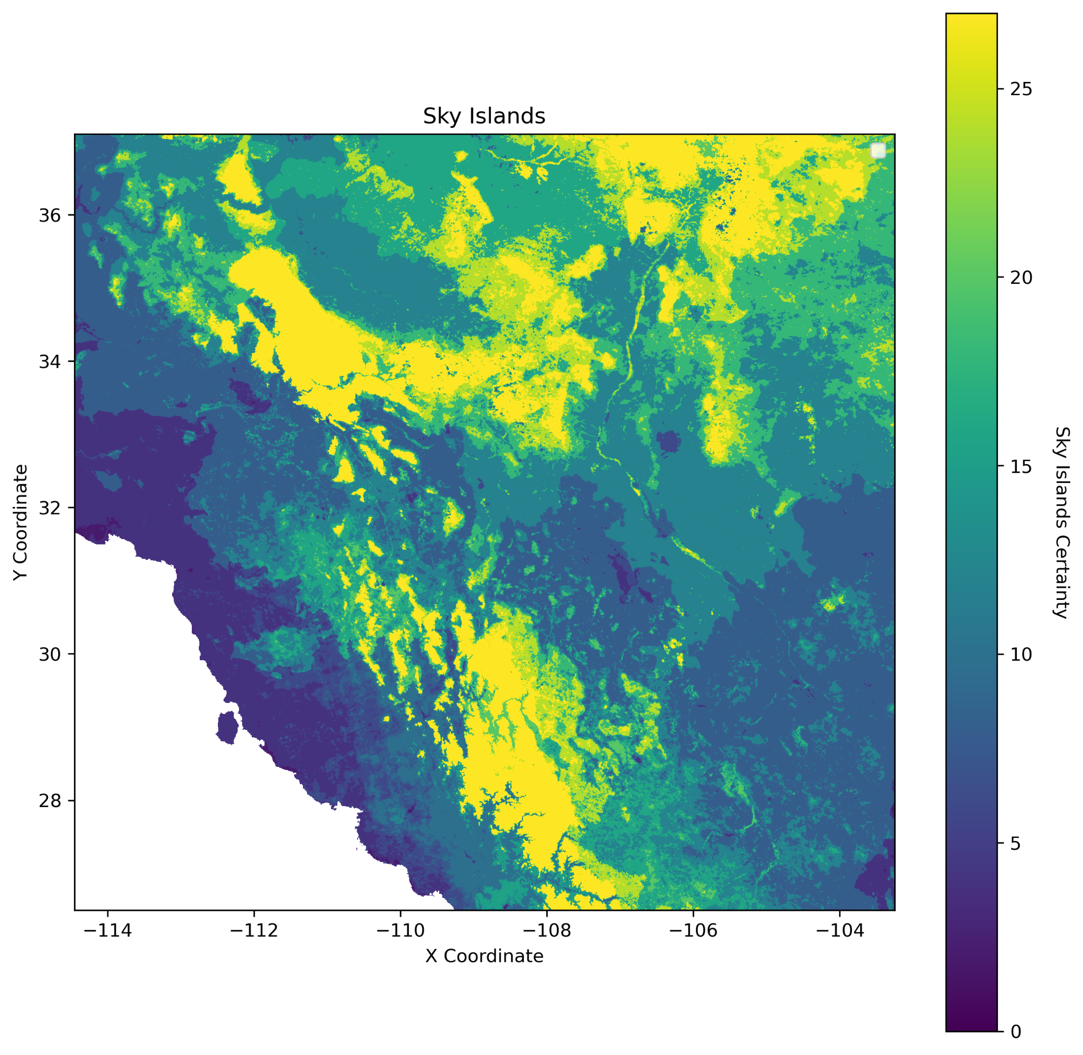
Today

Slide 4
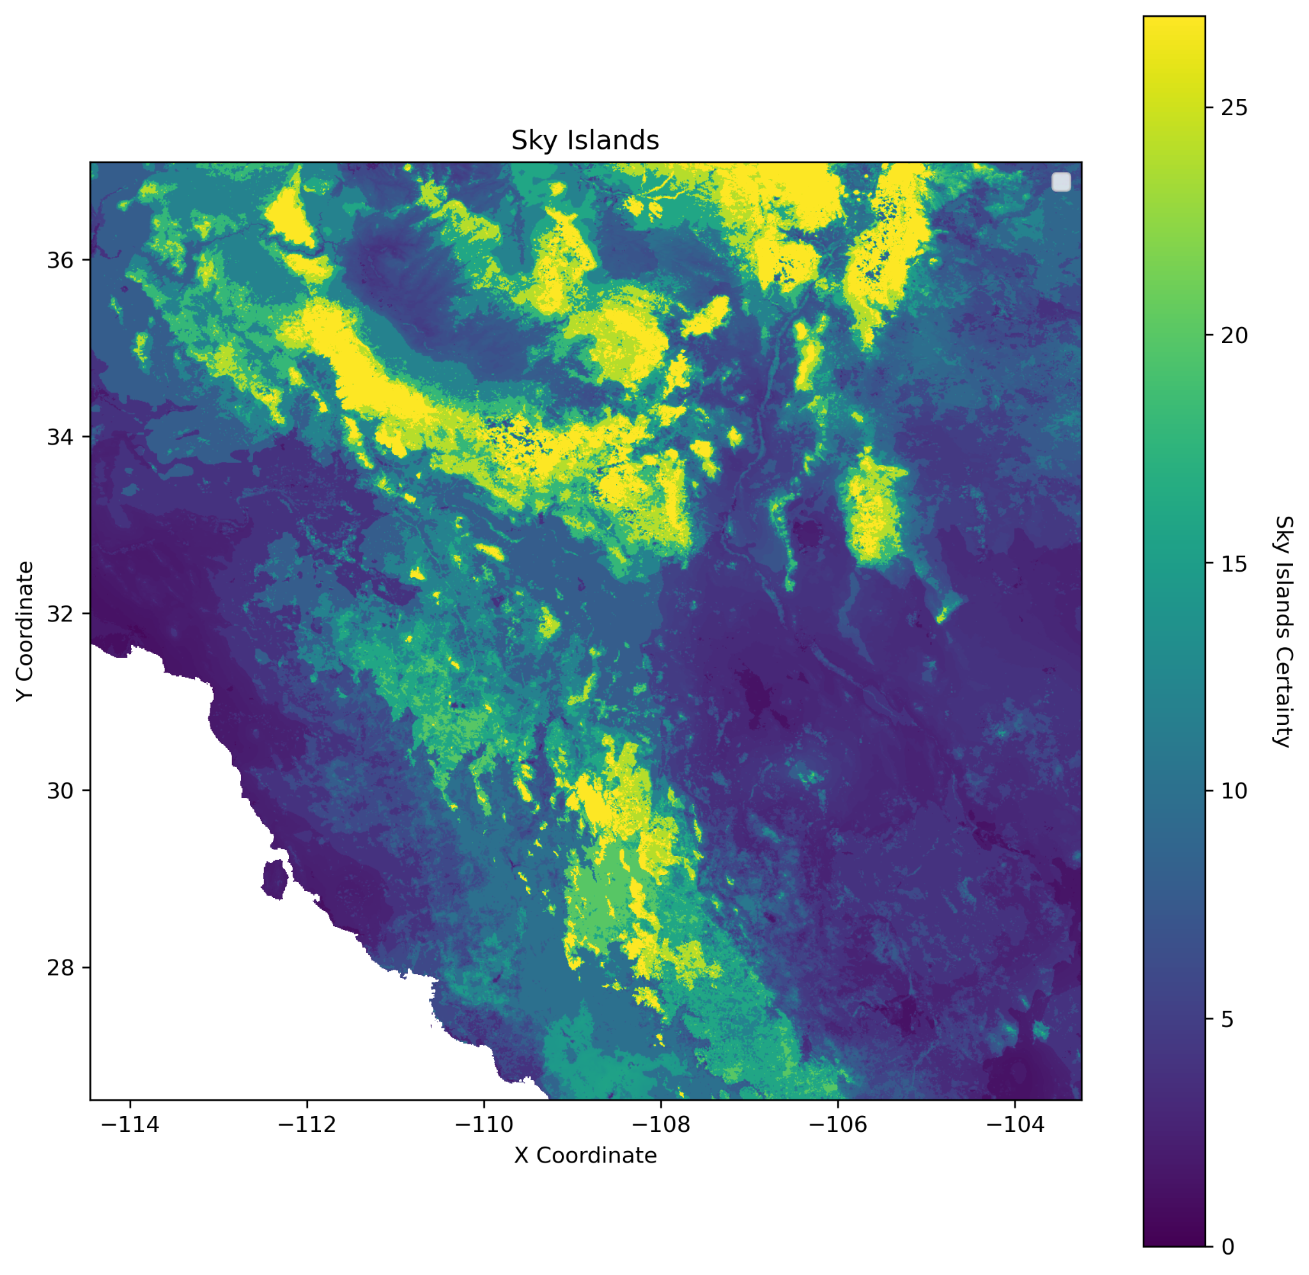
50 Years
Coe, Sharon J, et al. “Chapter 1: A Review of Historical Trends and Projections for Future Change of Climate and Vegetation.” An Assessment of Climate Change and the Vulnerability of Wildlife in the Sky Islands of the Southwest, USFS, Fort Collins, Colorado, 2012, pp. 1–12, doi.org/10.2737/RMRS-GTR-273. Accessed 25 Oct. 2024.

Slide 5
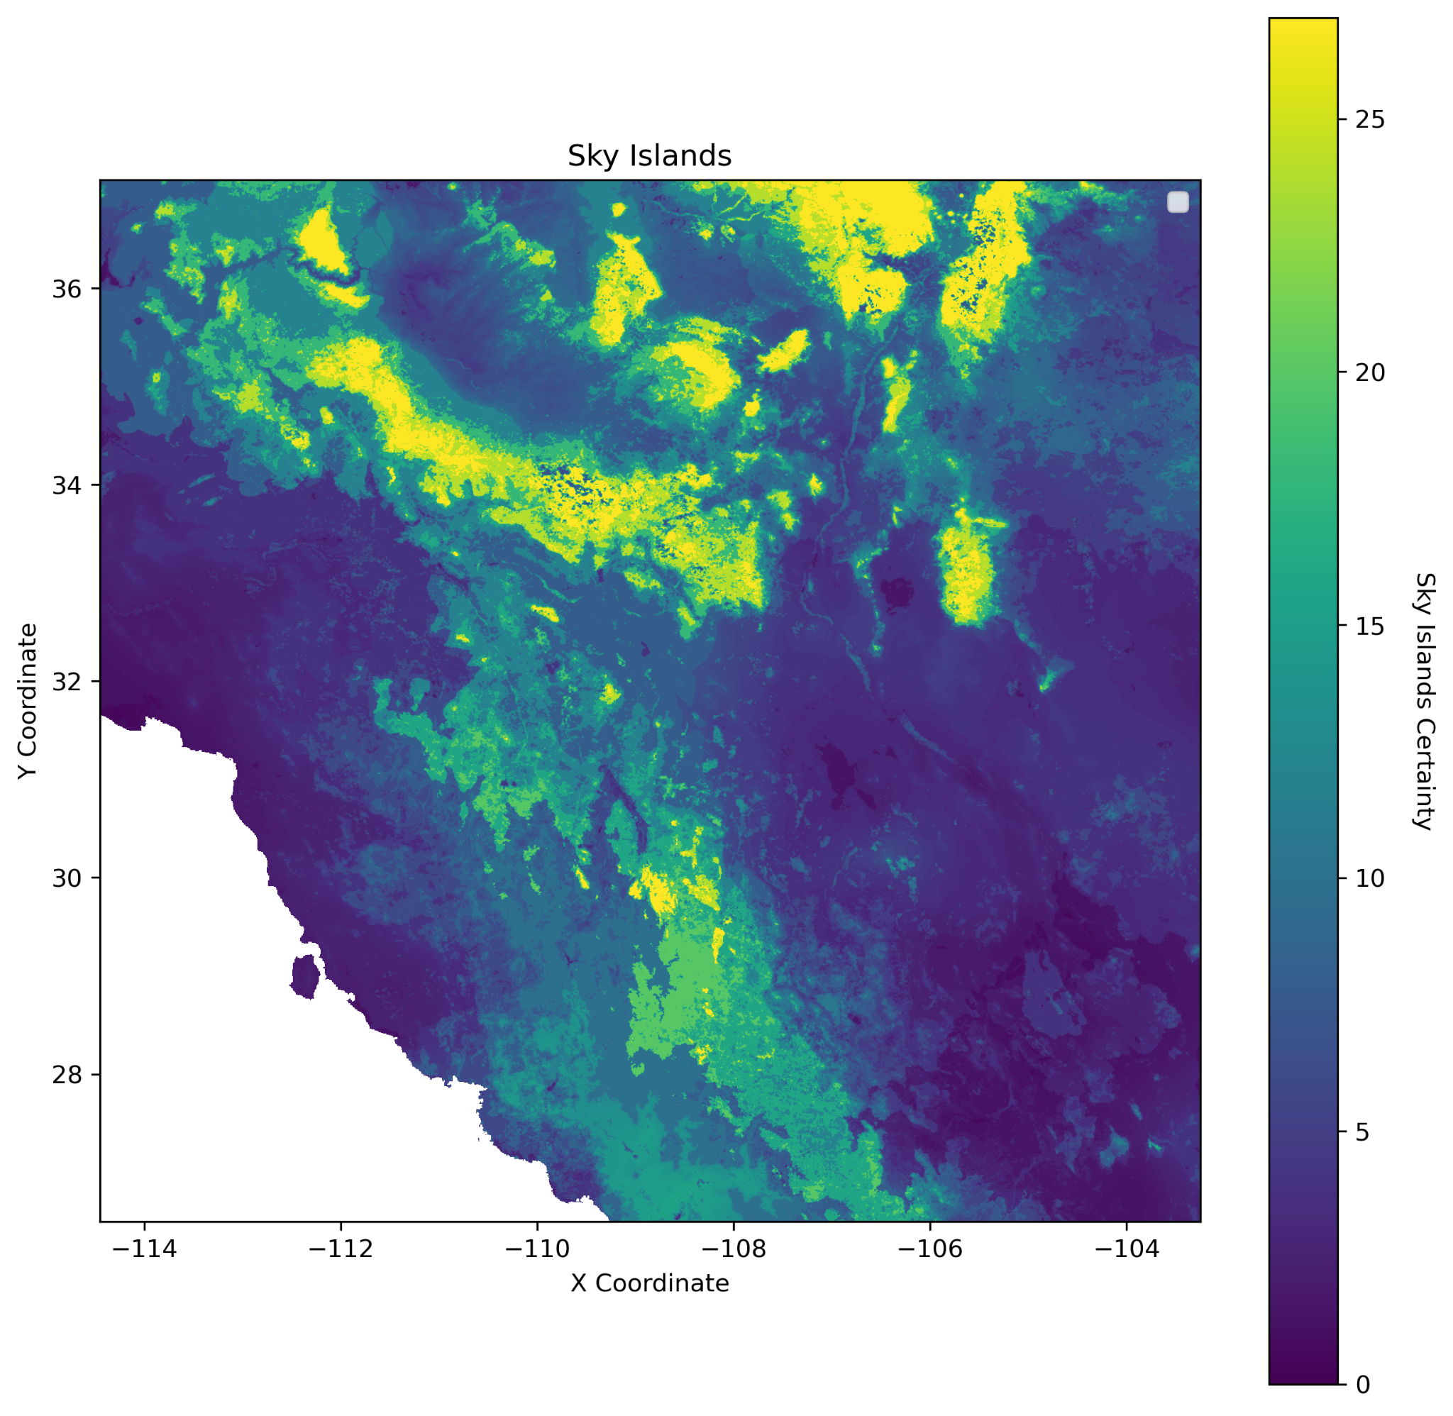
100 Years
Coe, Sharon J, et al. “Chapter 1: A Review of Historical Trends and Projections for Future Change of Climate and Vegetation.” An Assessment of Climate Change and the Vulnerability of Wildlife in the Sky Islands of the Southwest, USFS, Fort Collins, Colorado, 2012, pp. 1–12, doi.org/10.2737/RMRS-GTR-273. Accessed 25 Oct. 2024.

Slide 6
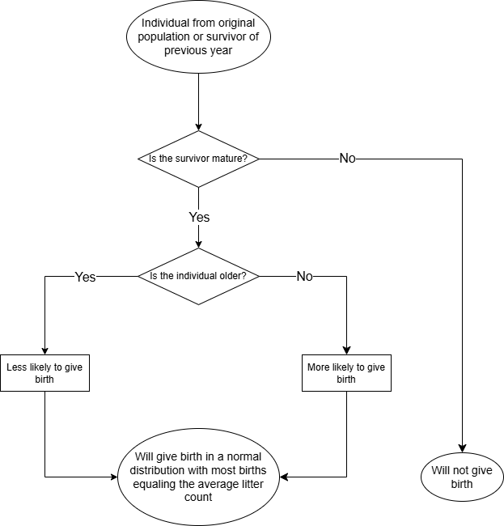
Birth Rate

Slide 7
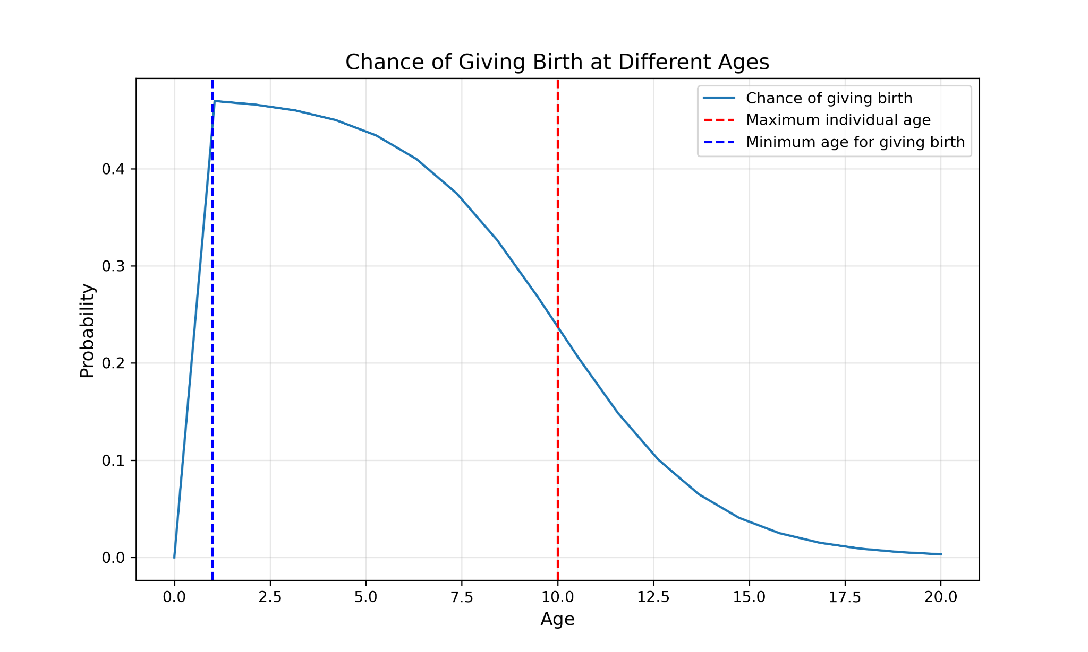
Birth Rate
Birth Rate = BBR * (1 / (1 + np.exp(0.5 * (x - 10))))

Slide 8
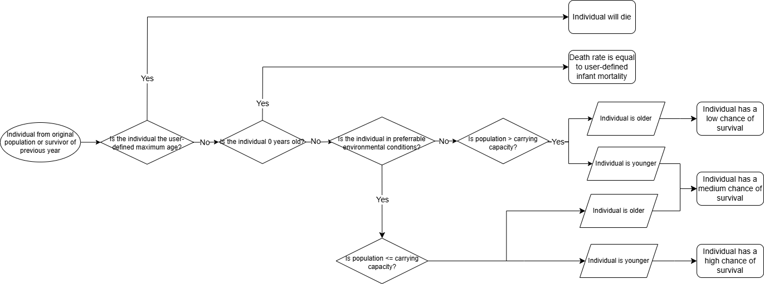
How Individuals Die

Slide 9
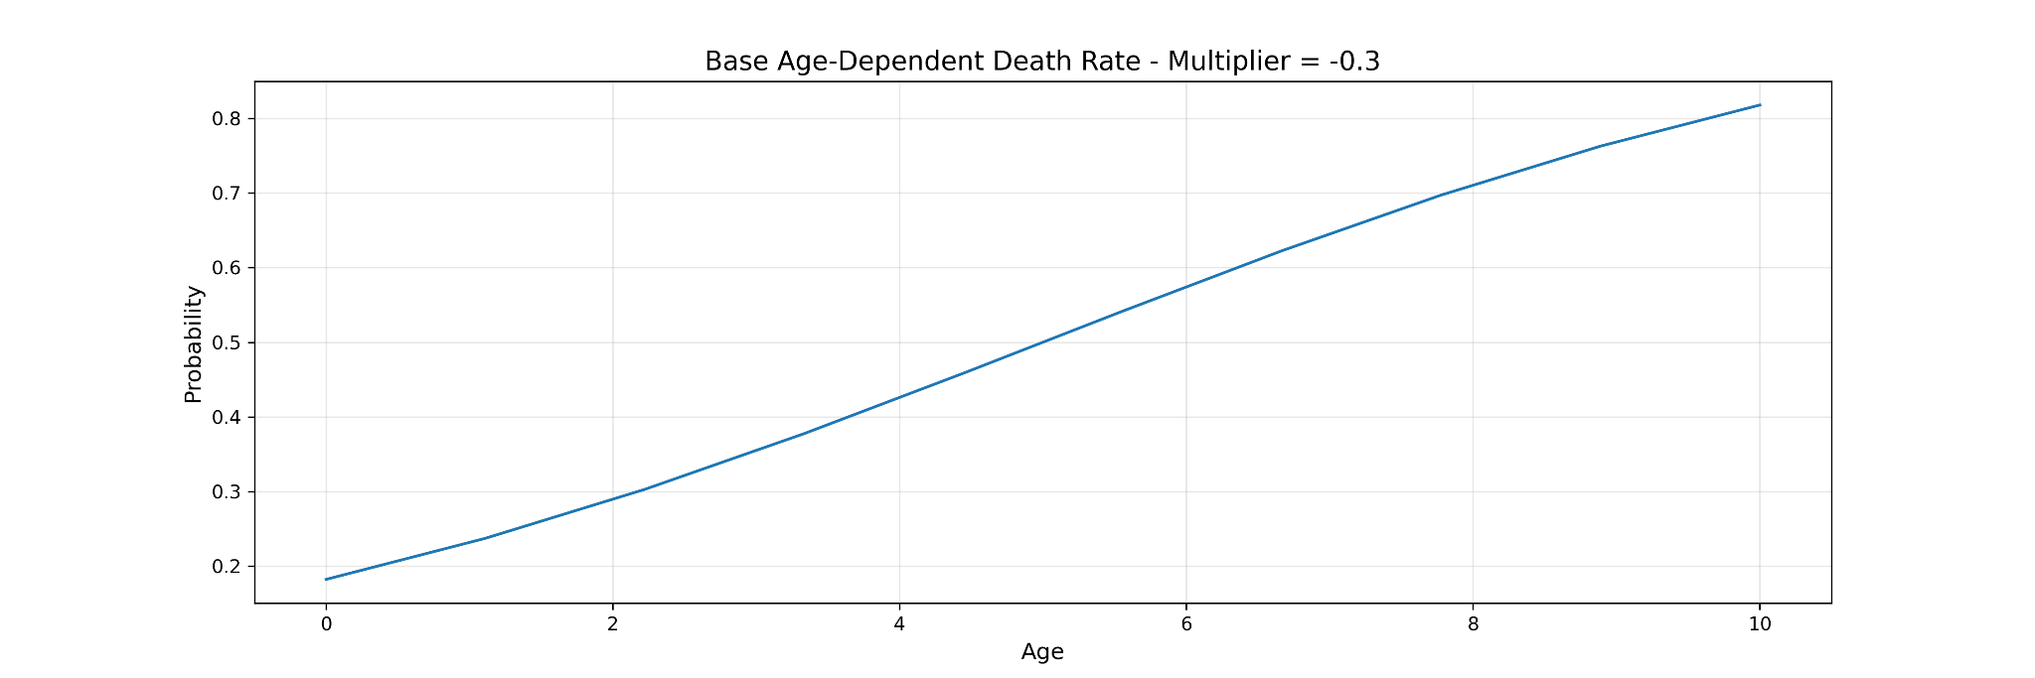
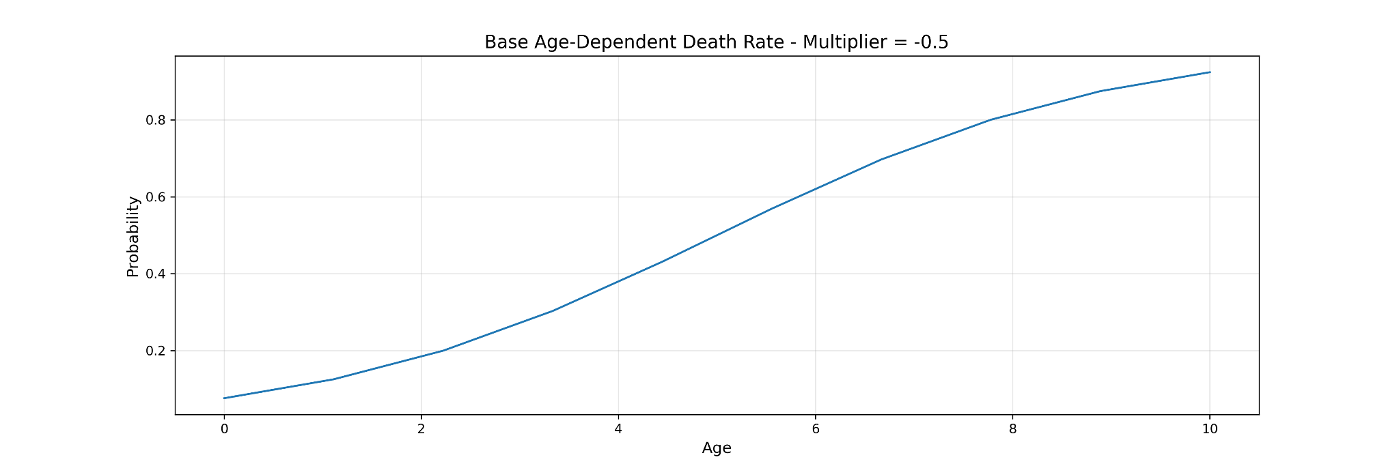
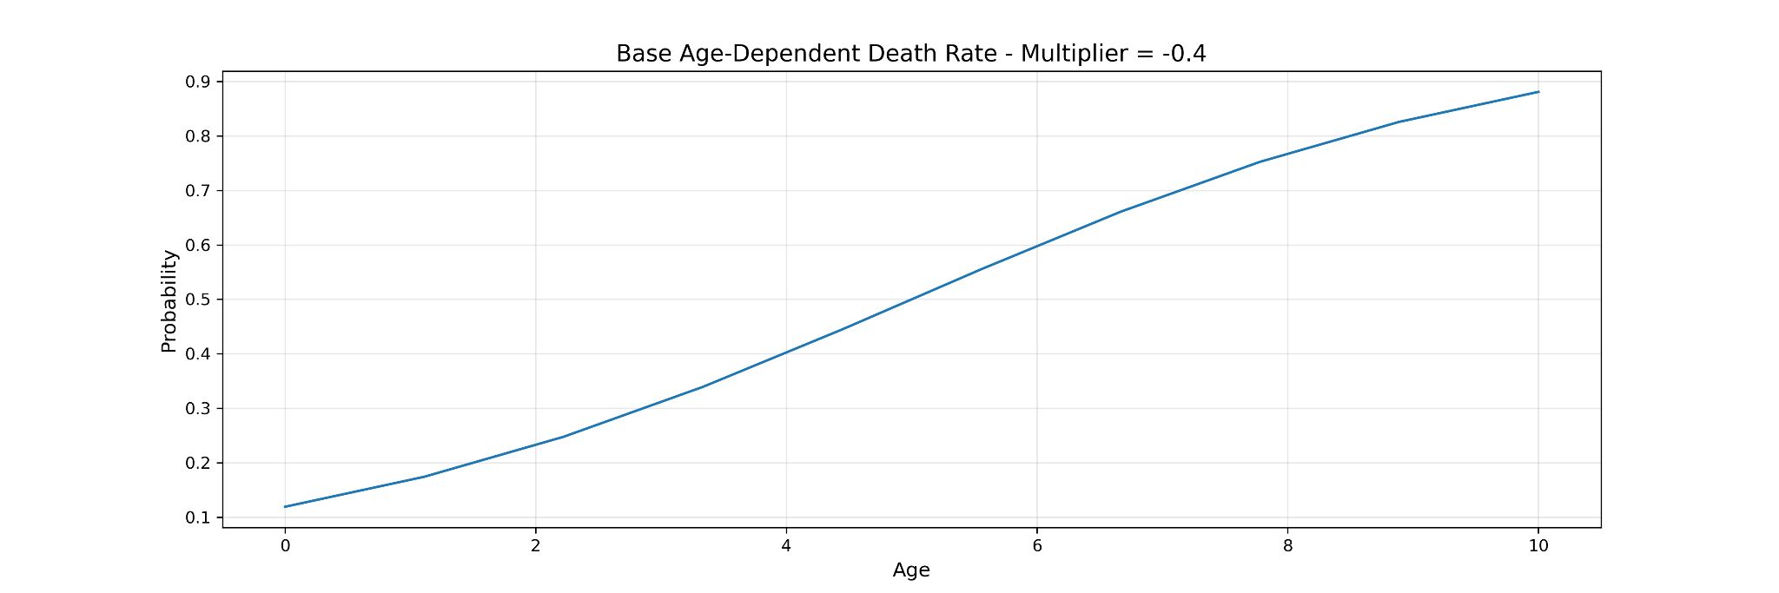
Death Rate
BDP = (1 / (1 + np.exp(-0.3 * (age - average_lifespan)))
BDP = (1 / (1 + np.exp(-0.5 * (age - average_lifespan)))
BDP = (1 / (1 + np.exp(-0.4 * (age - average_lifespan)))

Slide 10
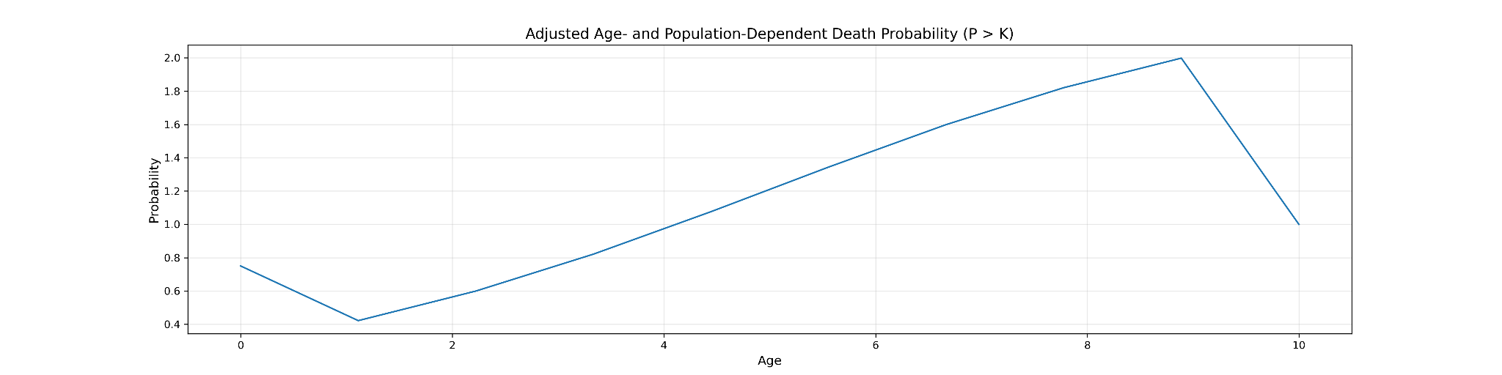
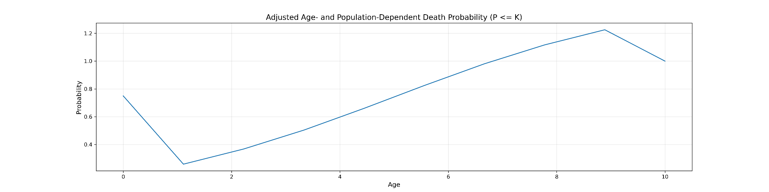
Death Rate
ADP = BDP * (2 * ((popSize / carrying_capacity) ** 2))
ADP = BDP * (2 * ((popSize / carrying_capacity) ** 0.1))

Slide 11
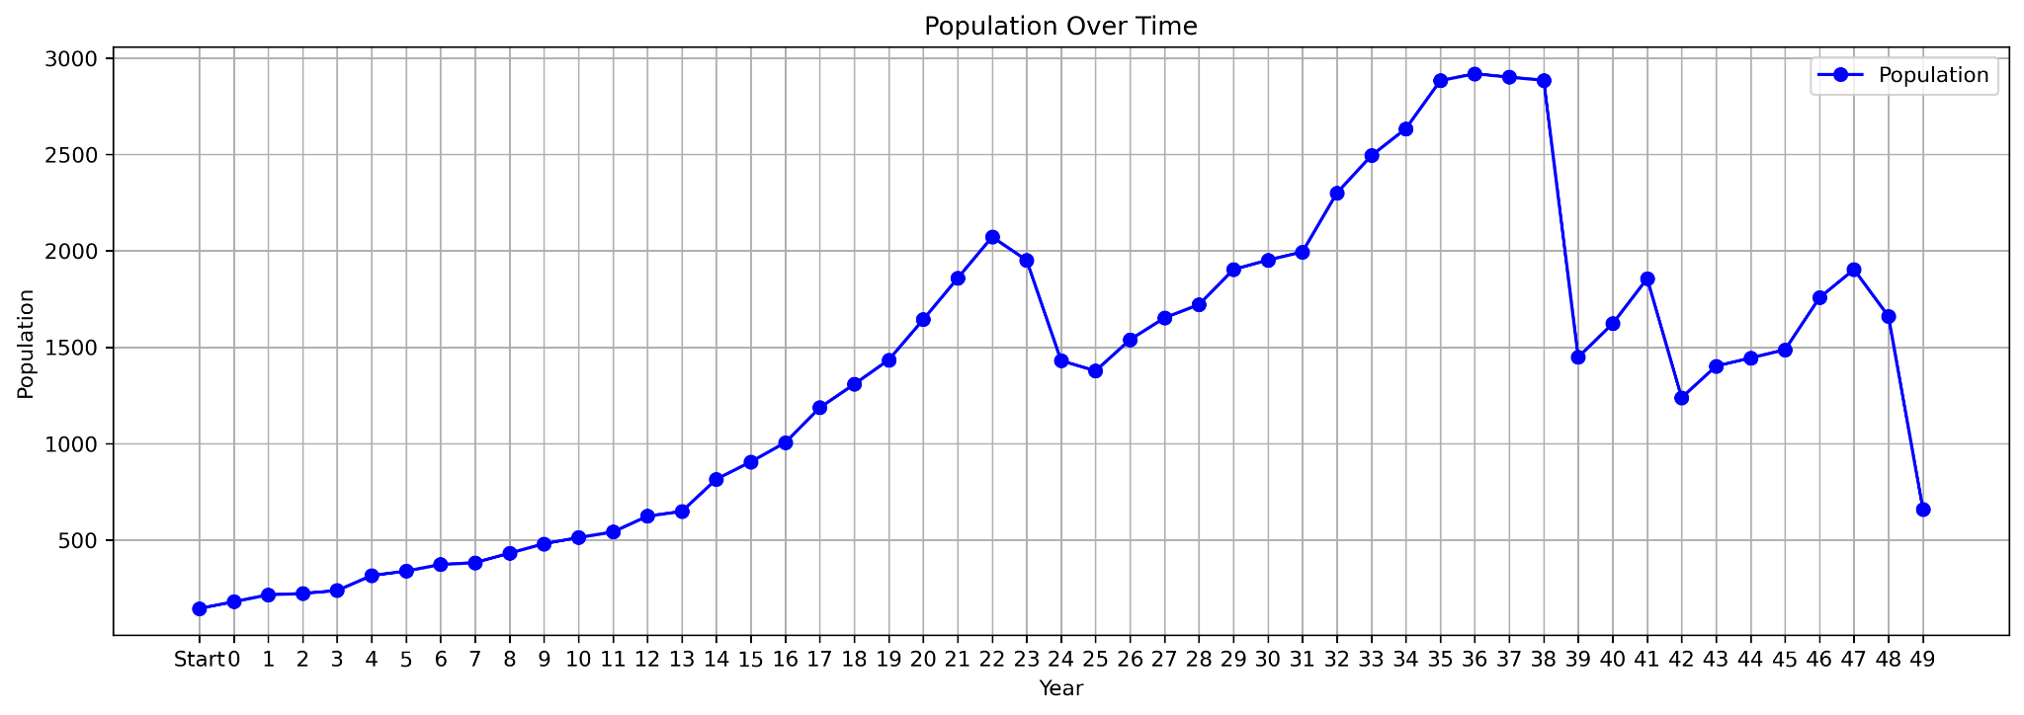
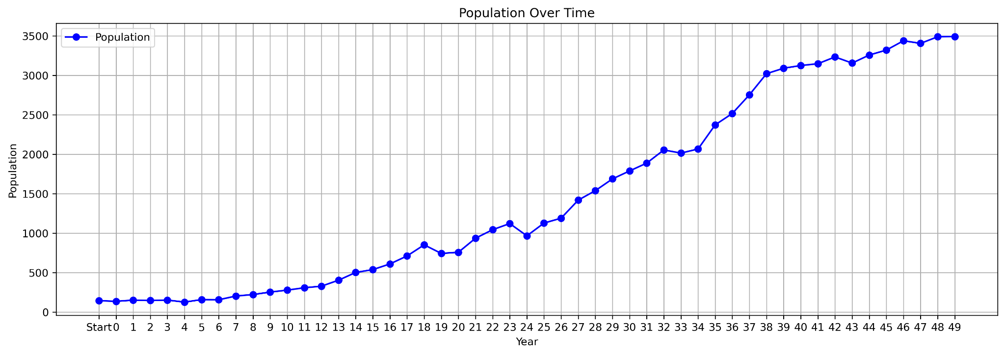
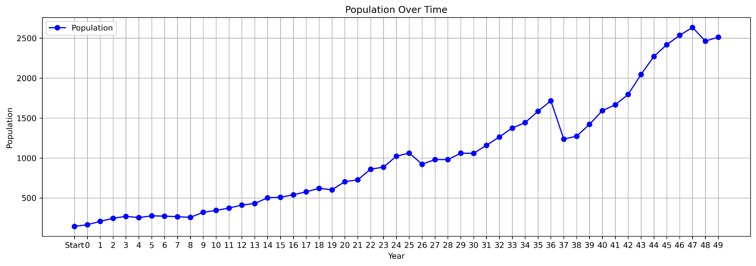
Population Simulations
Simulation 1
FDP = BDP * (1 + env_factor) * comp_factor (includes randomness)
Multiplier = 0.5

Slide 12
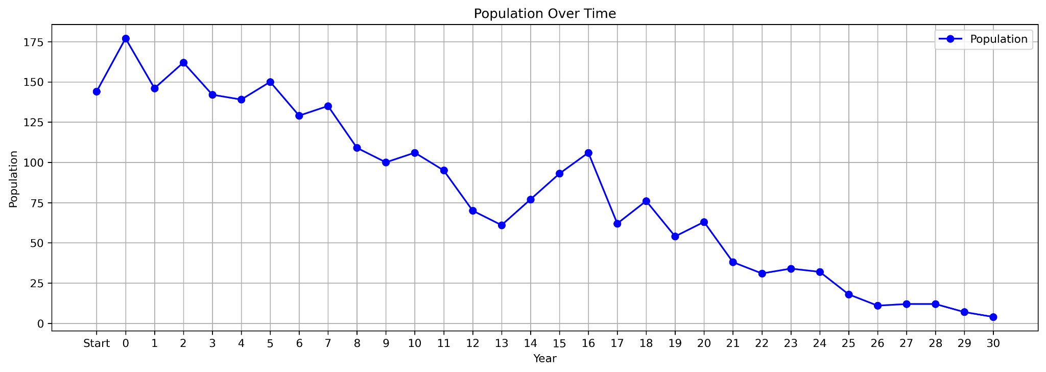
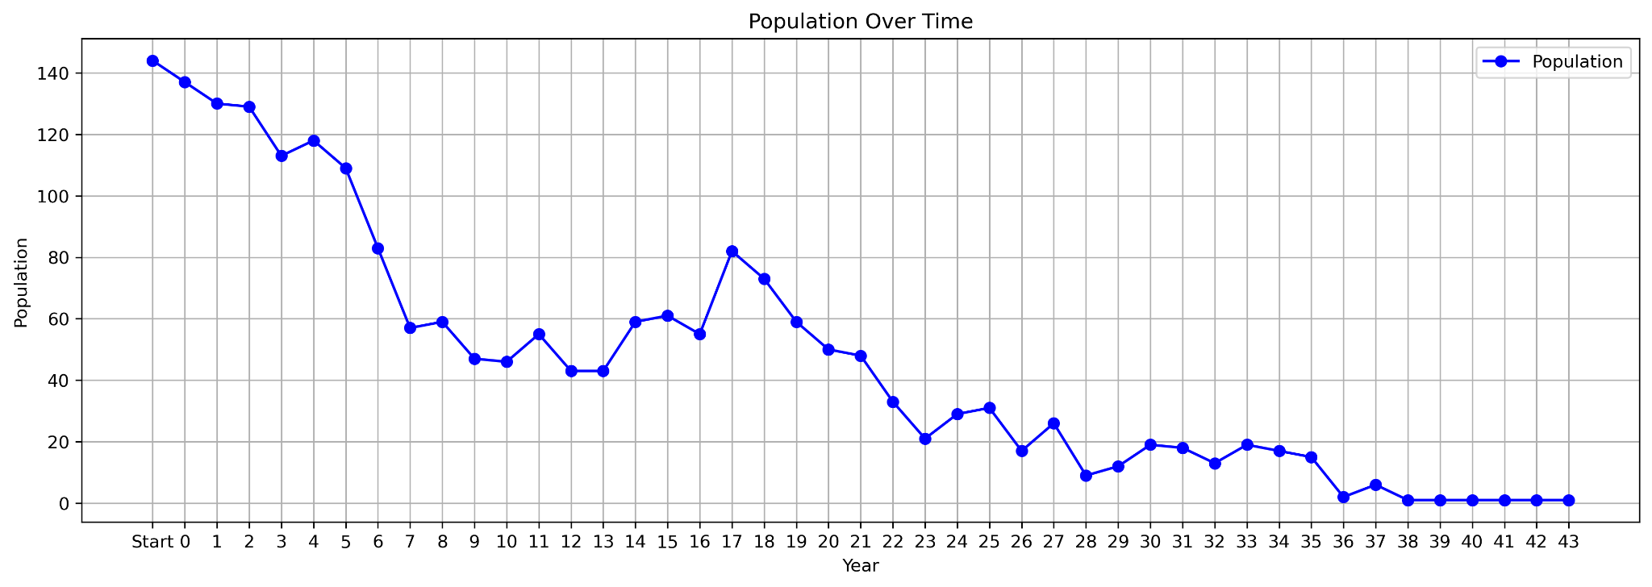
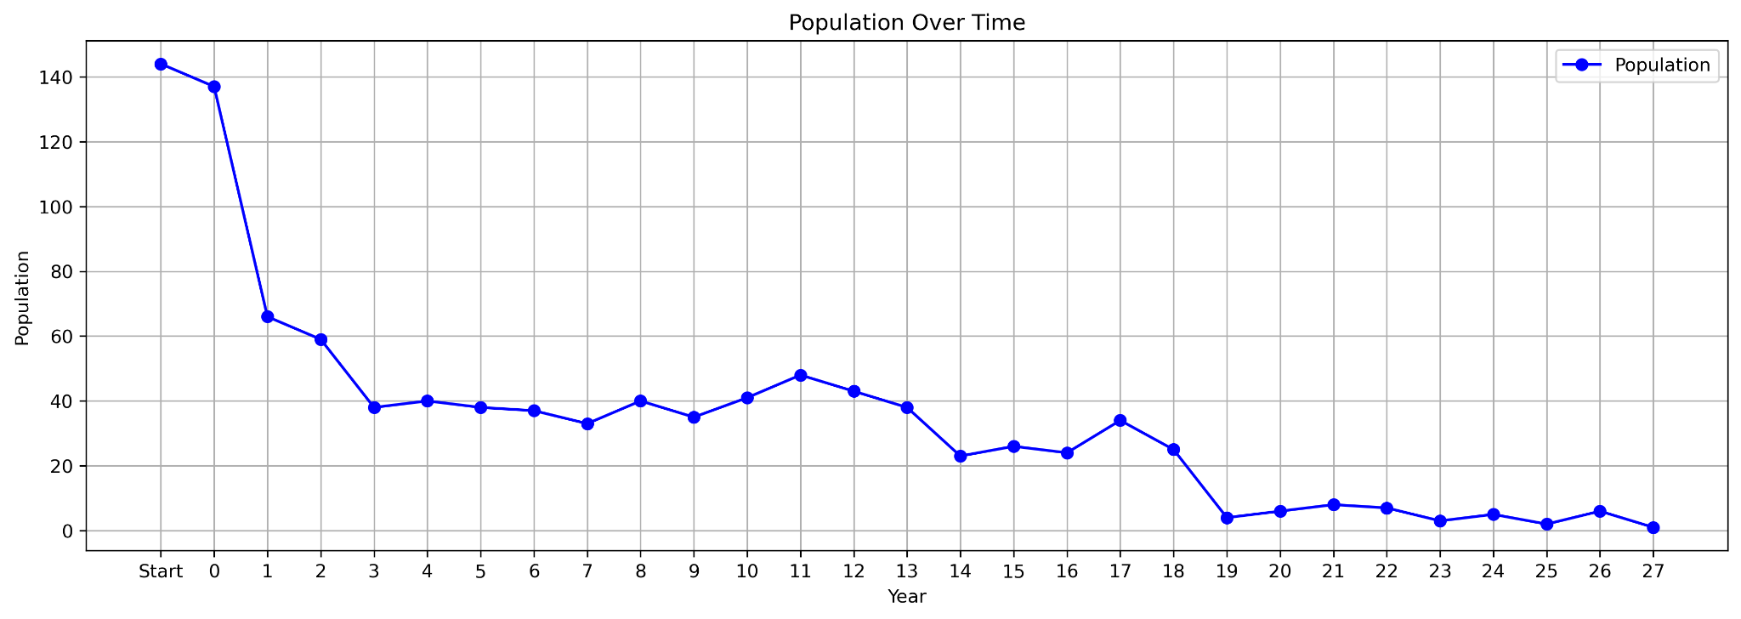
Population Simulations
Simulation 2
FDP = BDP * (1 + env_factor) * comp_factor (includes randomness)
Multiplier = 0.3

Slide 13
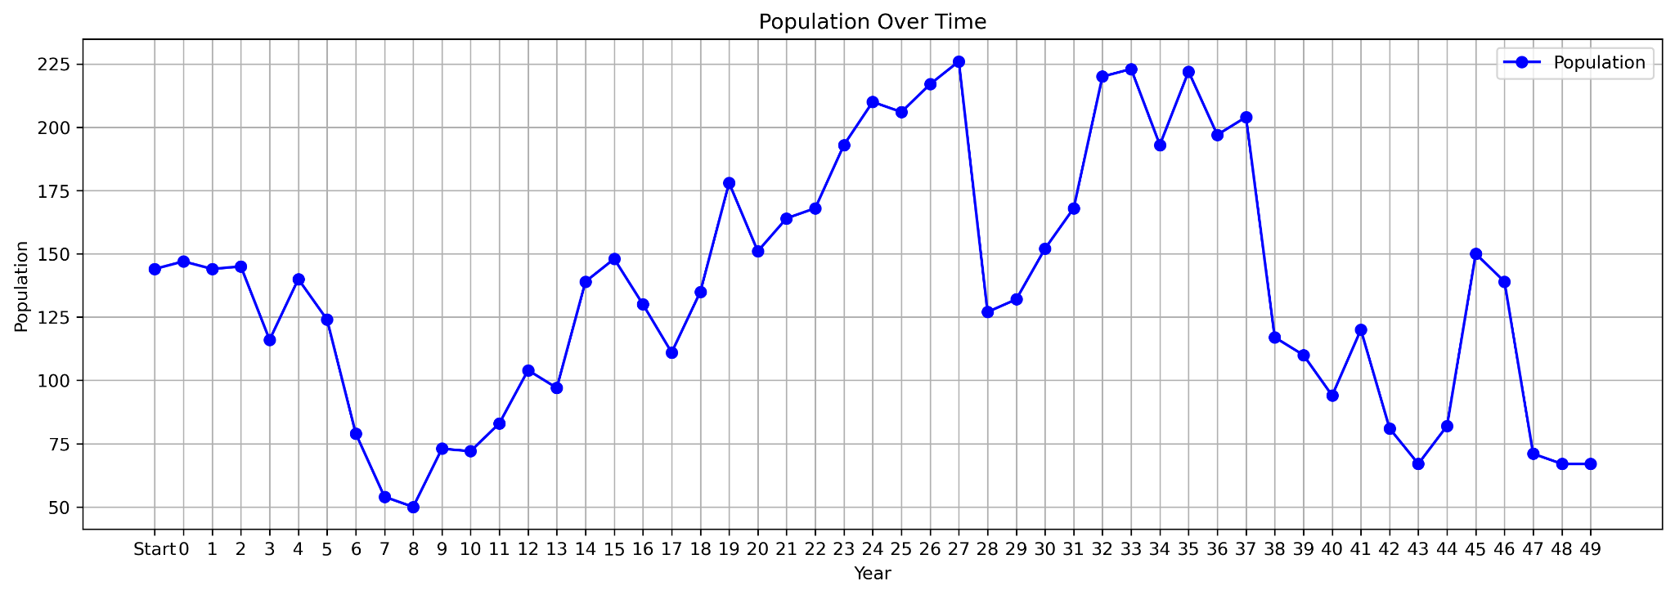
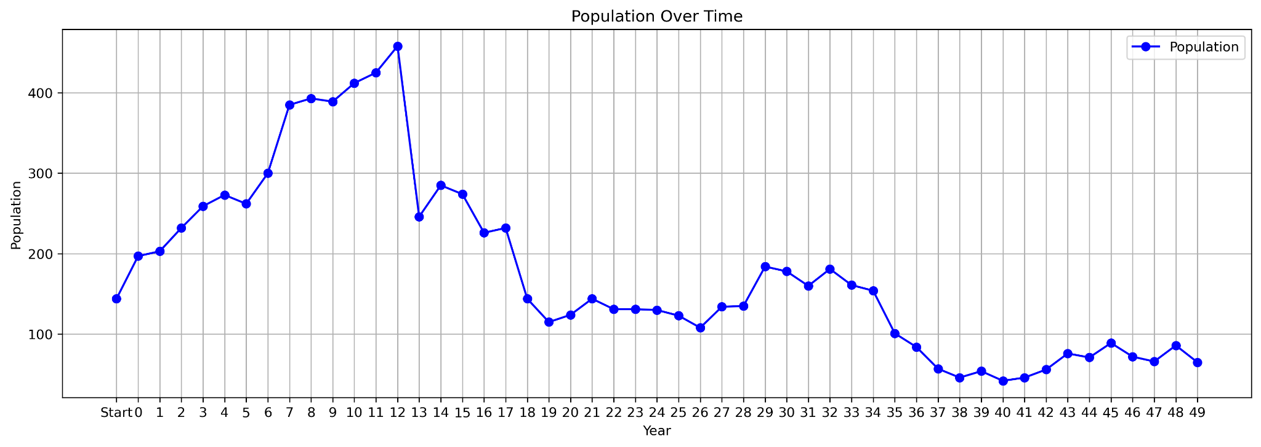
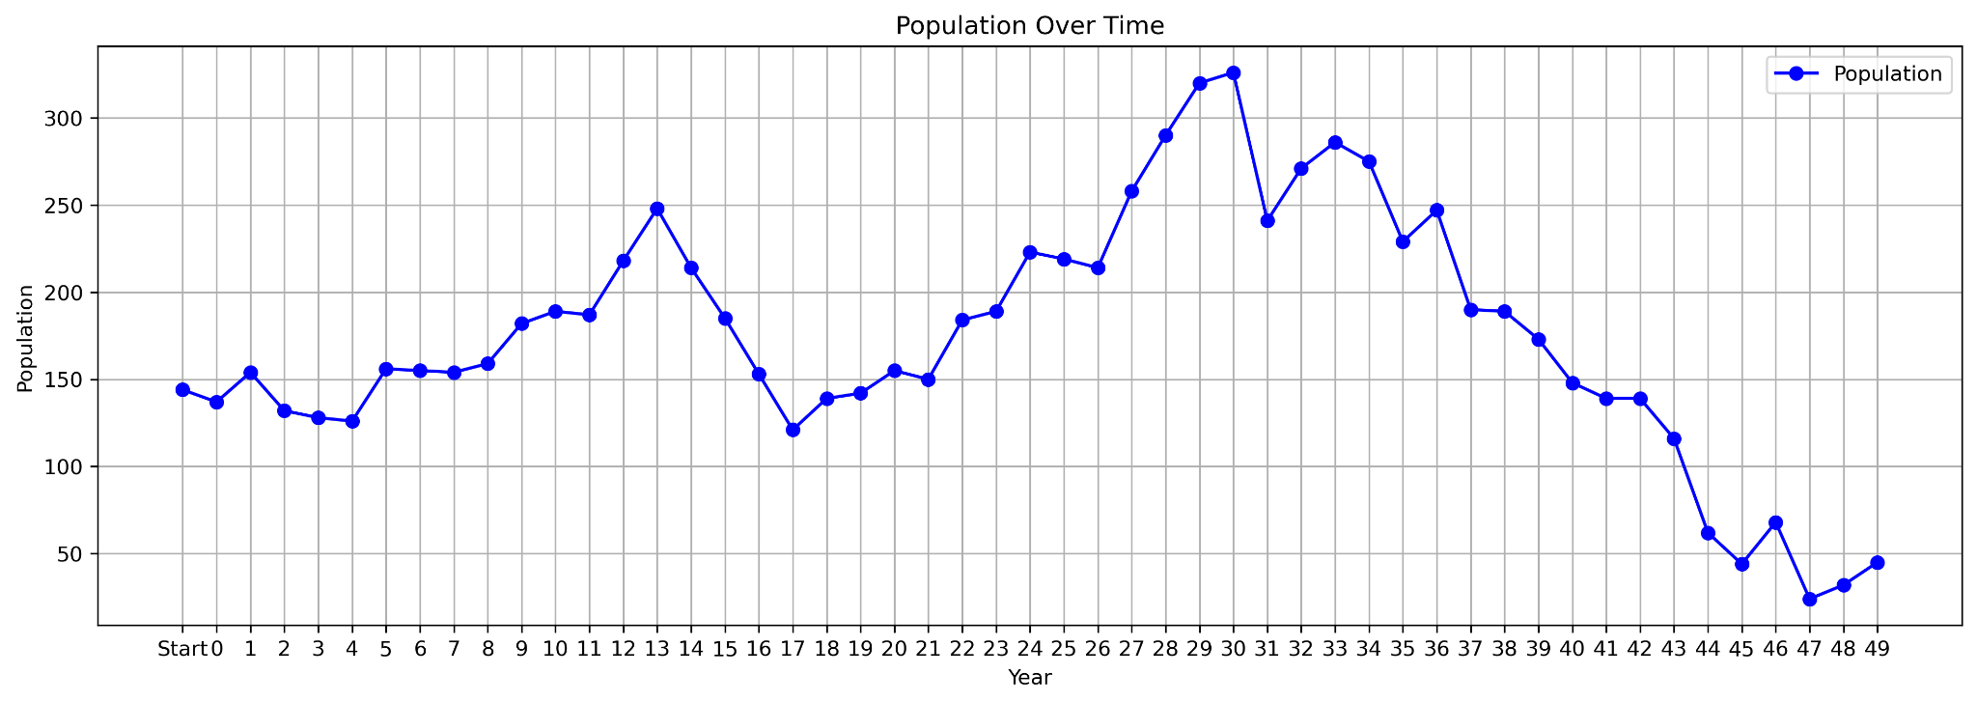
Population Simulations
Simulation 3
FDP = BDP * (1 + env_factor) * comp_factor (includes randomness)
Multiplier = 0.4

Slide 14
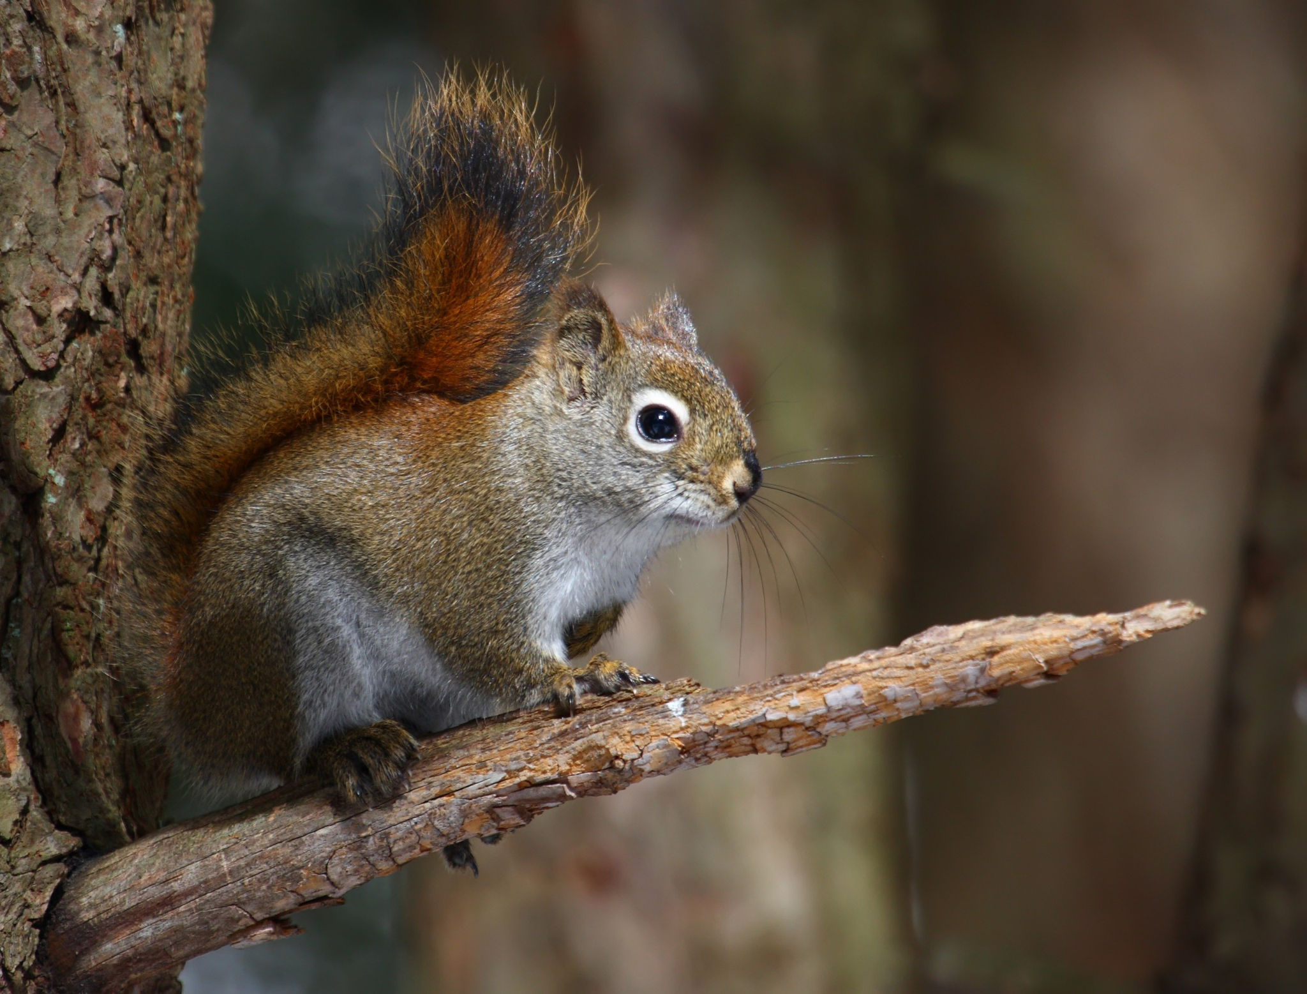
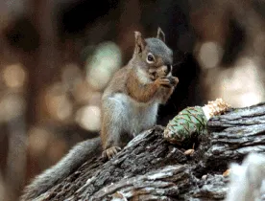
Choosing Preferences
Not much occurrence data for Mount Graham red squirrel
Preference distributions acquired from red squirrels within the southwestern United States (Arizona and New Mexico)
This species was the most recent common ancestor of Mount Graham red squirrels
American red squirrel (Tamiasciurus hudsonicus)
Mount Graham red squirrel (Tamiasciurus hudsonicus grahamensis)

Slide 15
Choosing Preferences
Precipitation and temperature data
Monthly 30-year averages from WorldClim
1-km spatial resolution
Vegetation (NDVI)
Monthly 2023 NDVI values taken from eVIIRS
375-meter spatial resolution
Values are collected and averaged between 7 or 14 days

Slide 16
Choosing Preferences
Raster cell values were extracted at each occurrence data point
Preference Values
5
4
6
2
6
2
3
7
5 | 7 | 3 | 4 | 9
8 | 6 | 1 | 2 | 3
3 | 9 | 7 | 2 | 4
6 | 6 | 2 | 3 | 8
1 | 3 | 3 | 7 | 7
5 | 7 | 3 | 4 | 9
8 | 6 | 1 | 2 | 3
3 | 9 | 7 | 2 | 4
6 | 6 | 2 | 3 | 8
1 | 3 | 3 | 7 | 7

Slide 17
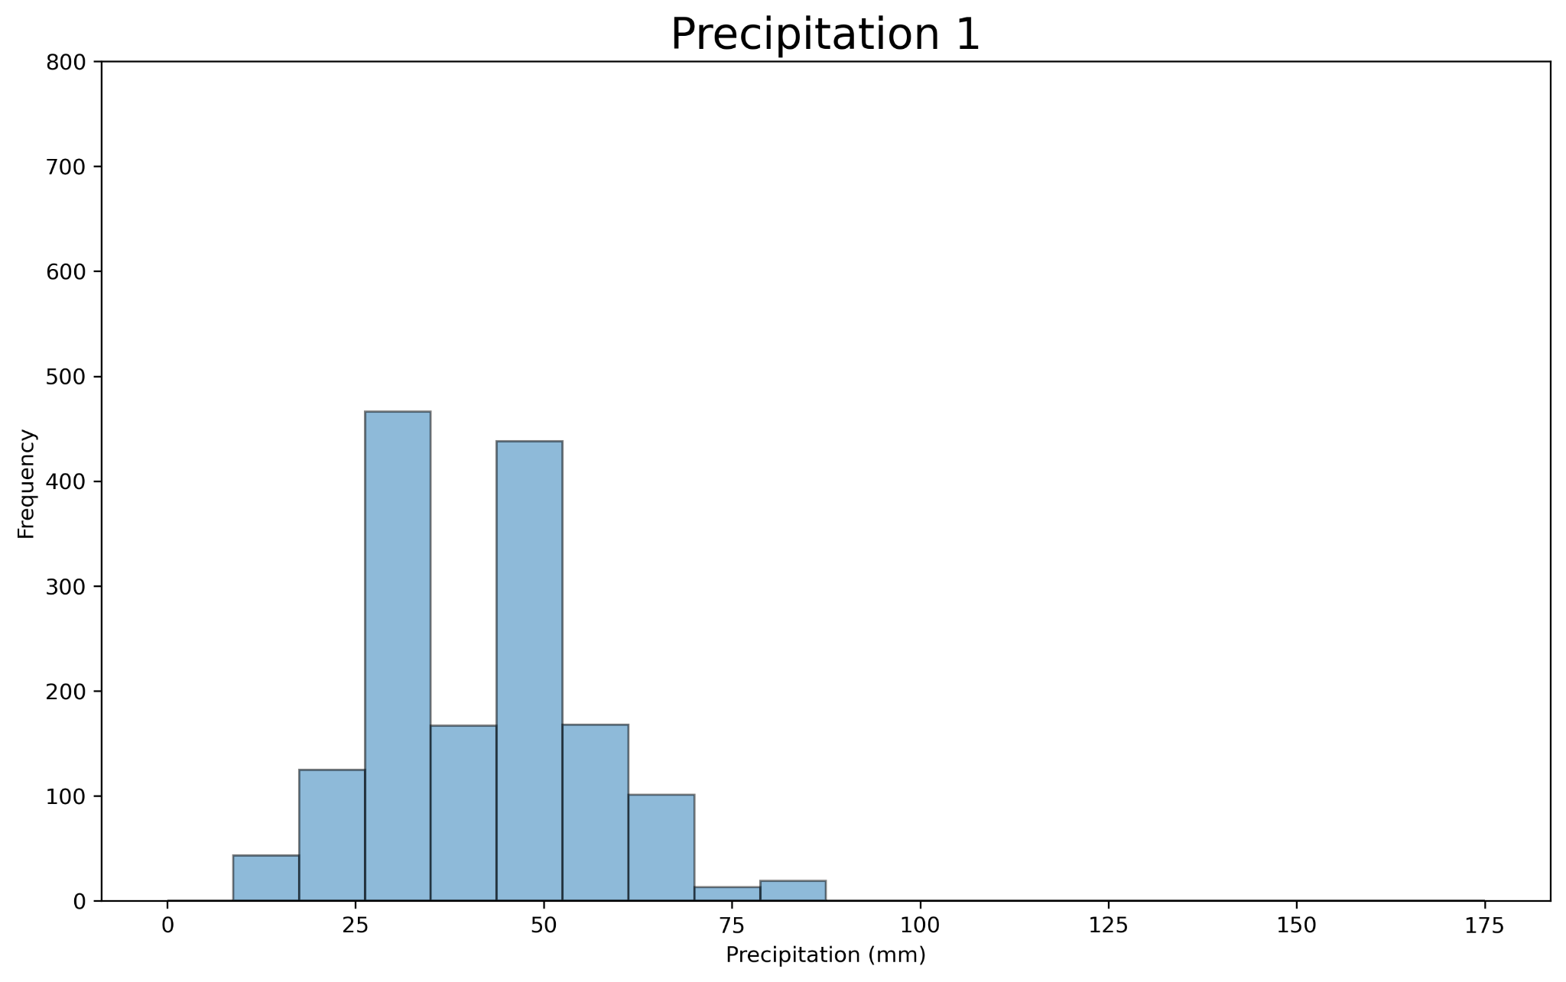
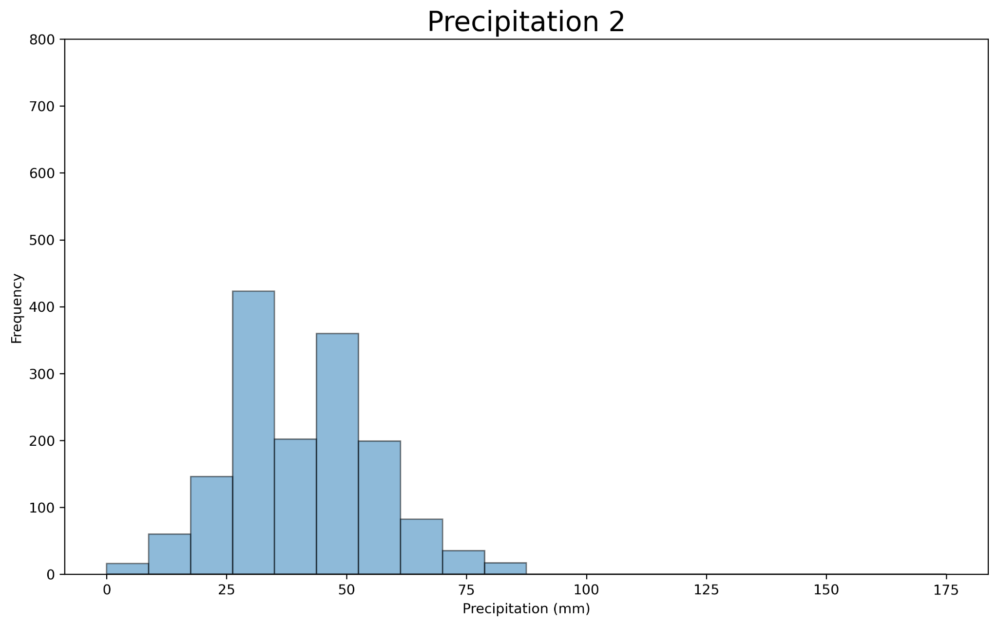
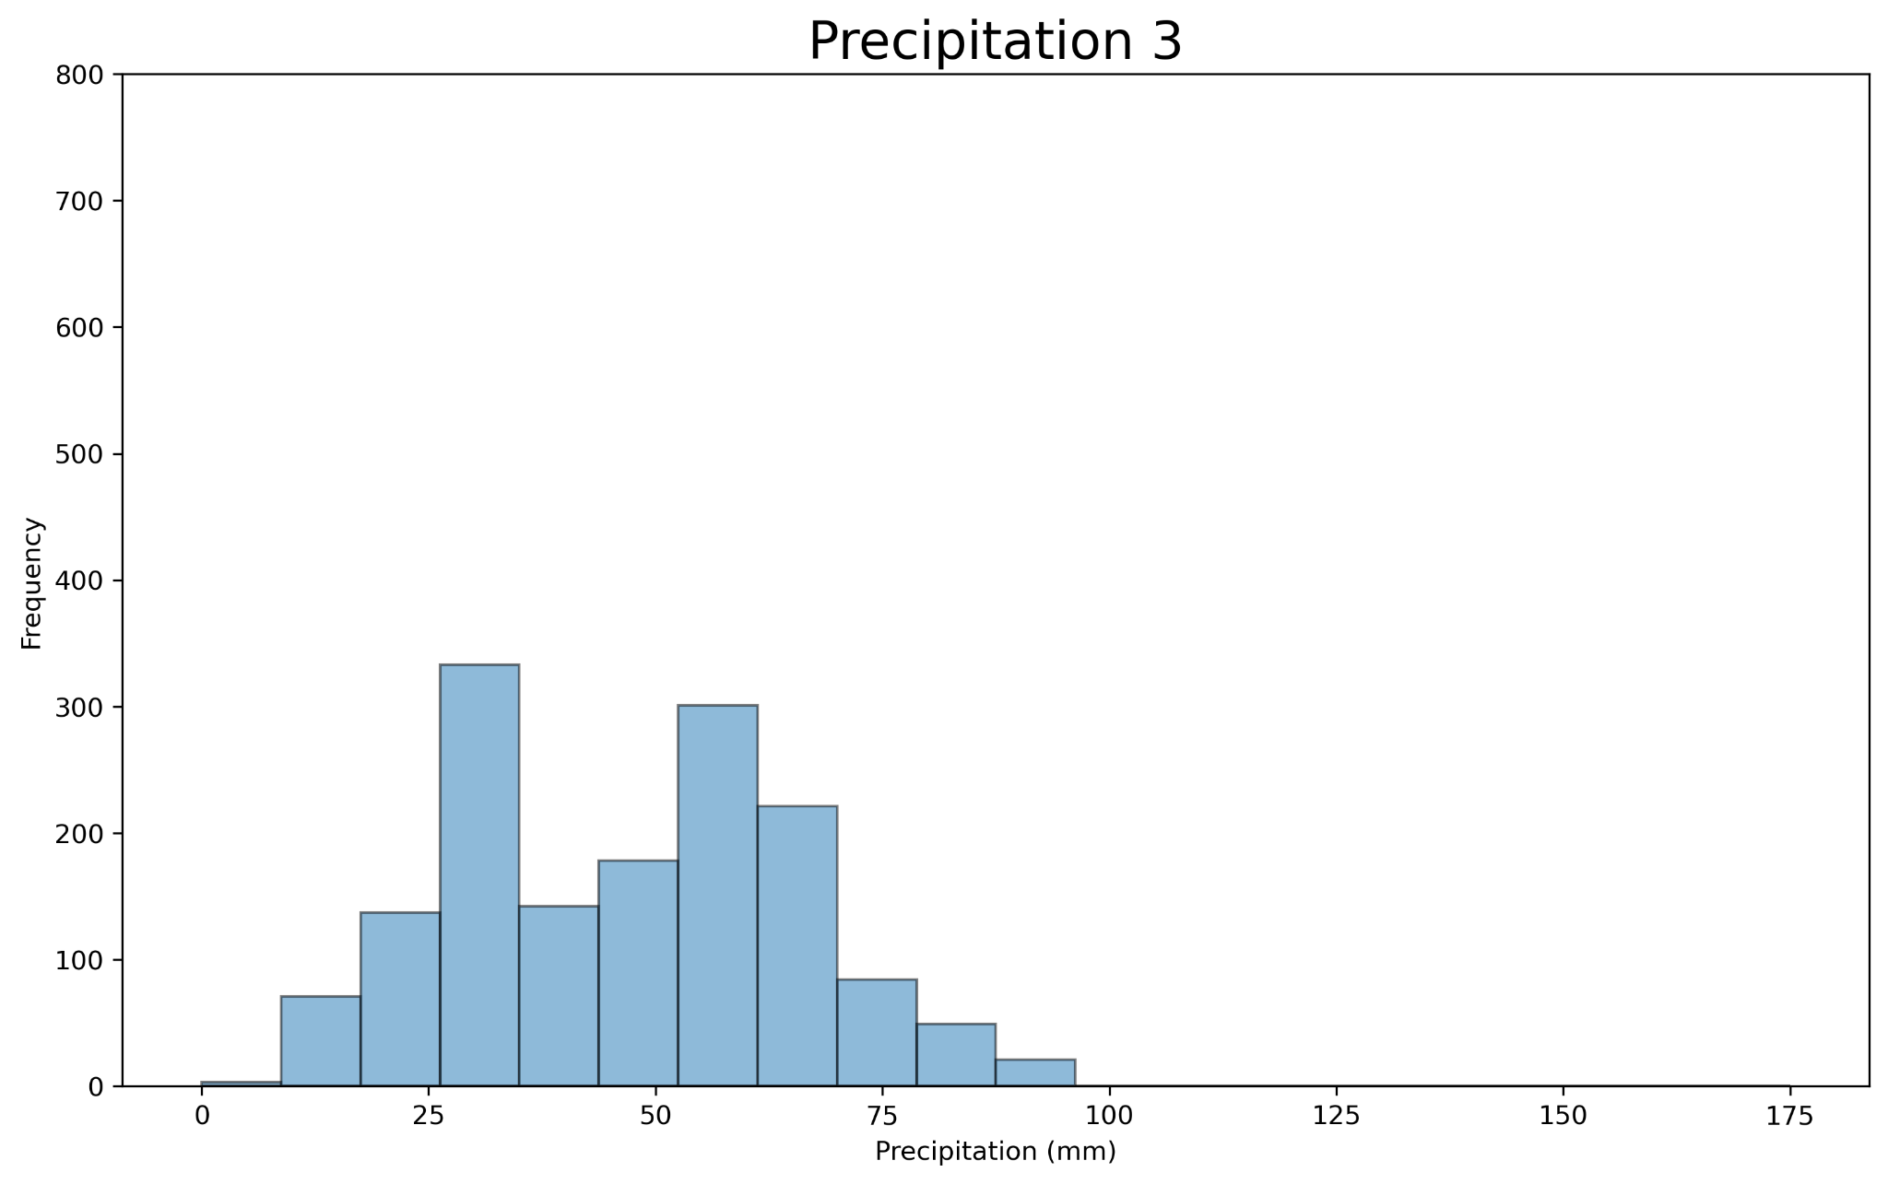
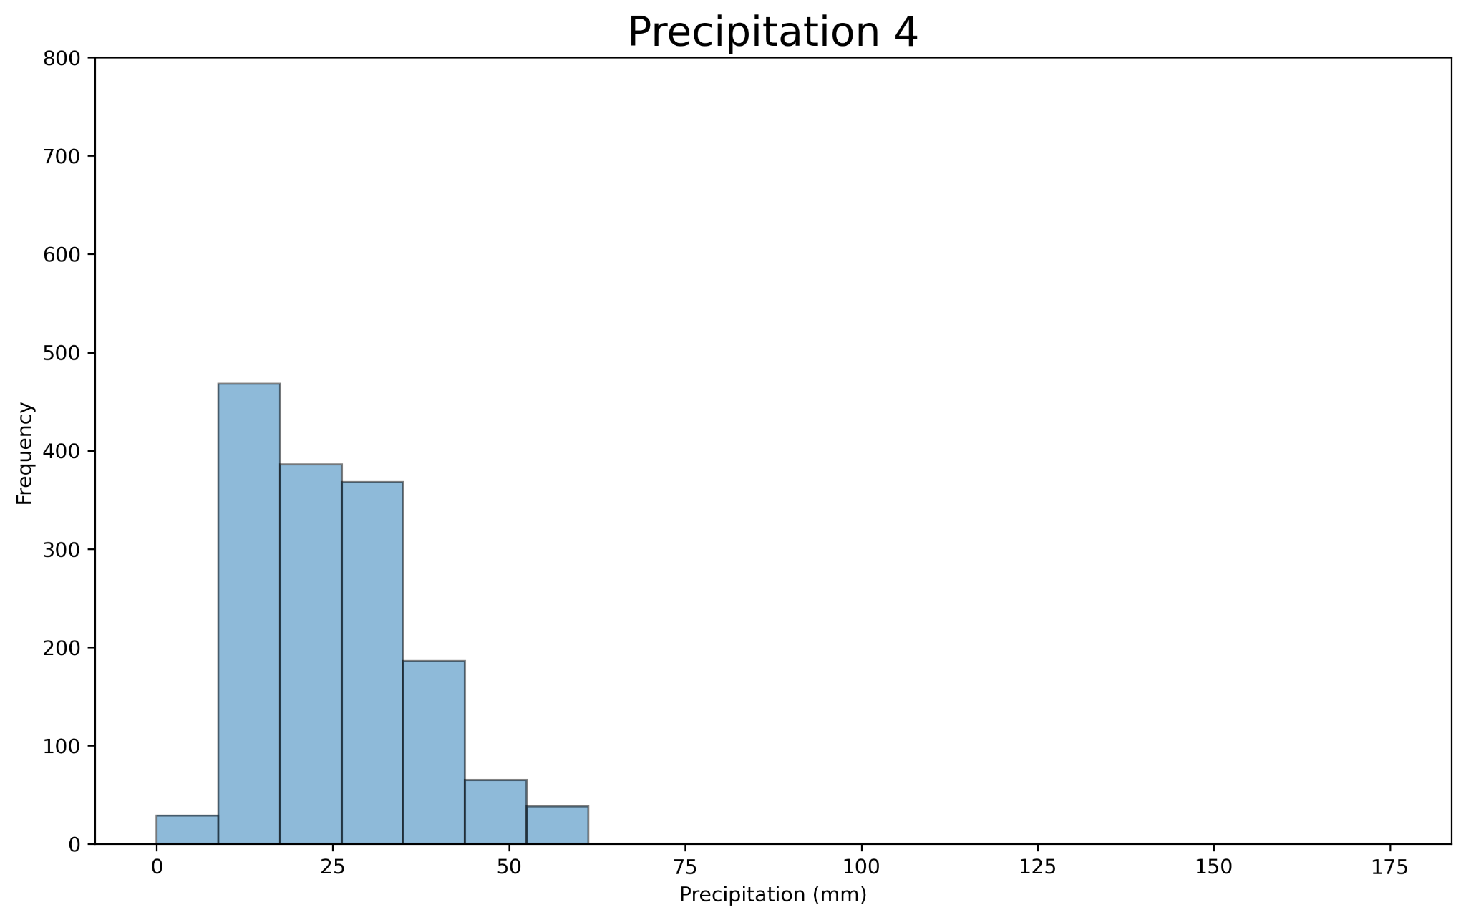
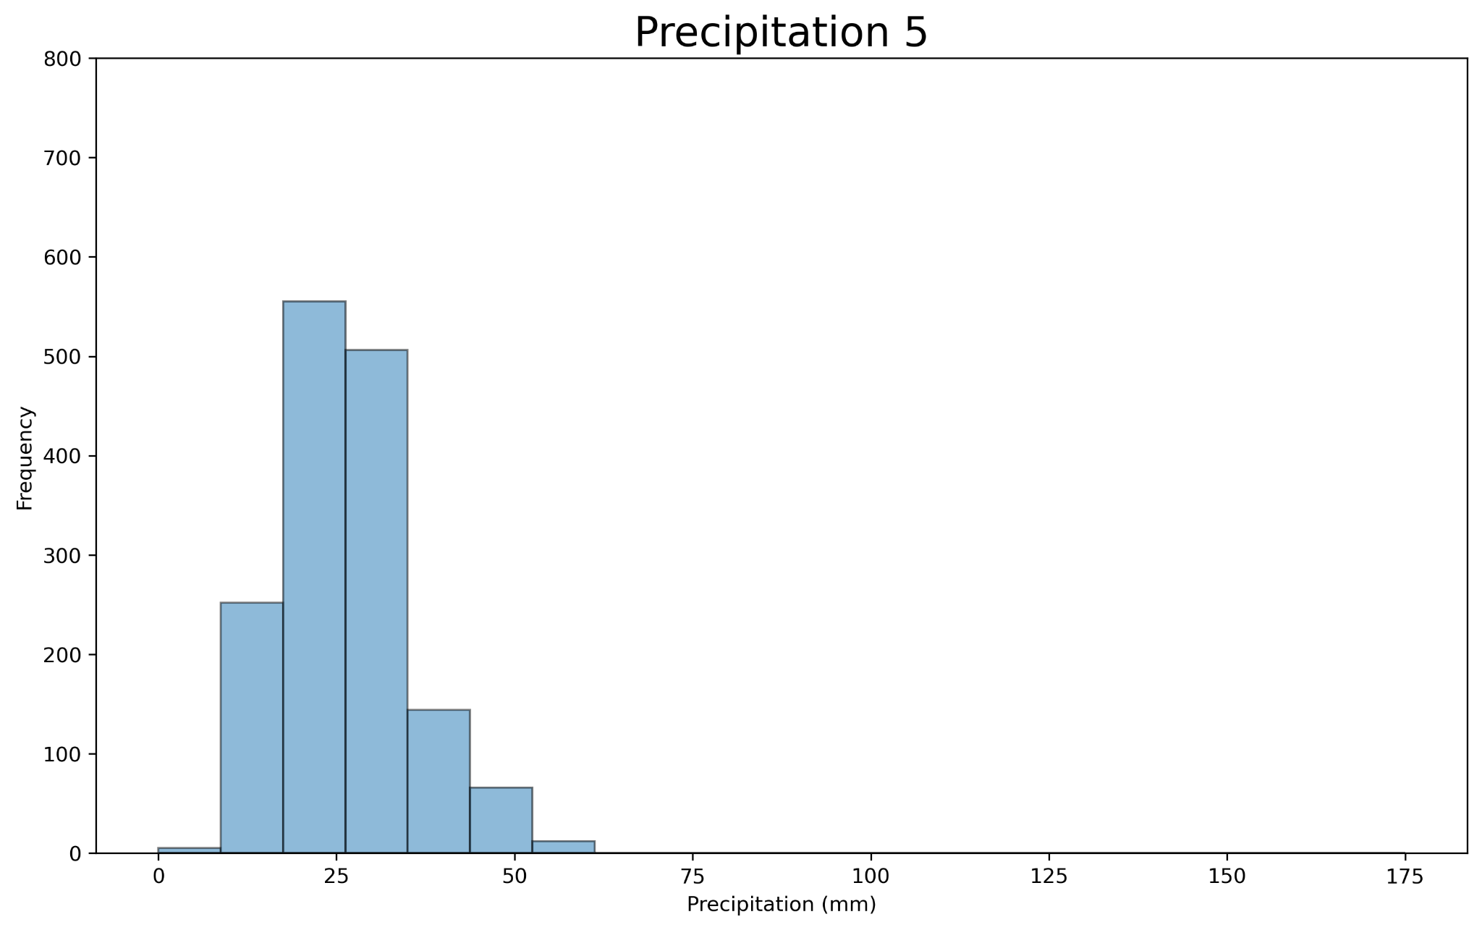
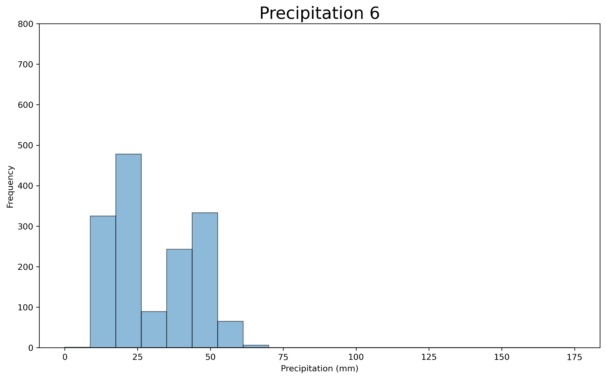
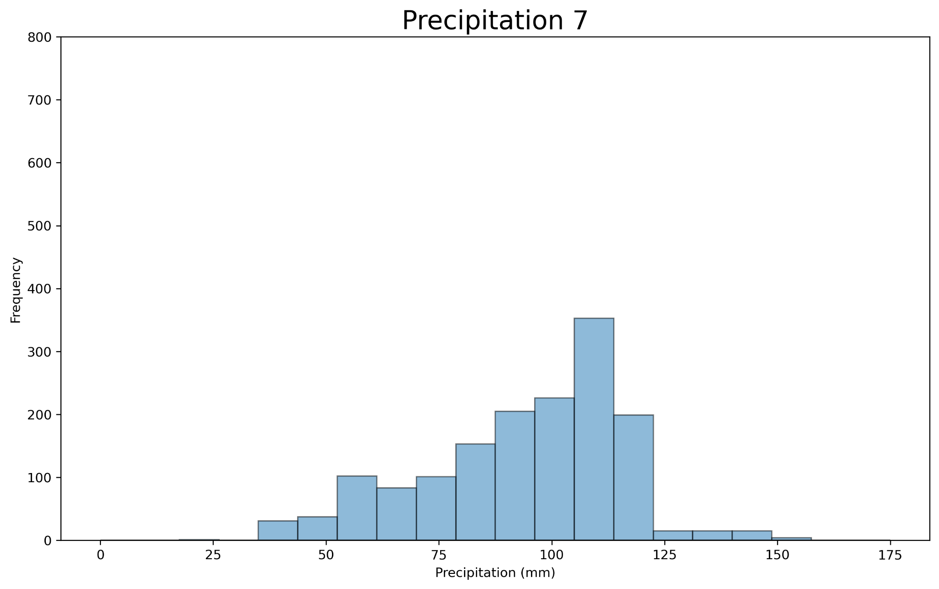
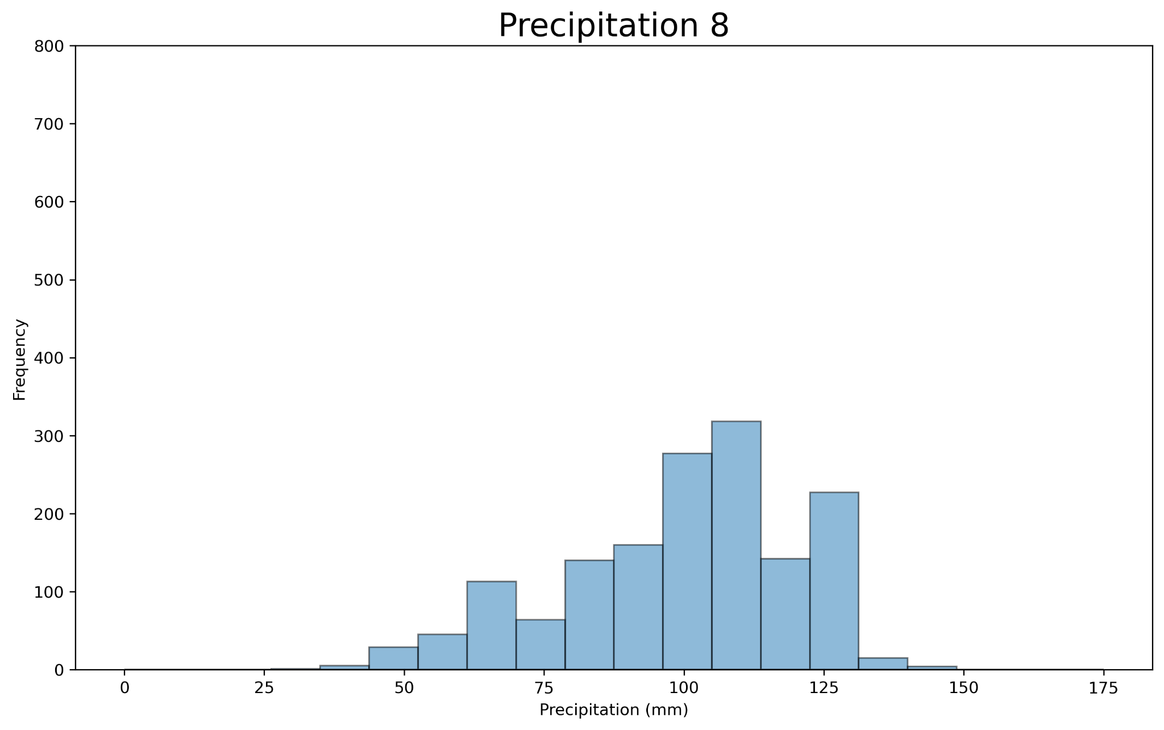
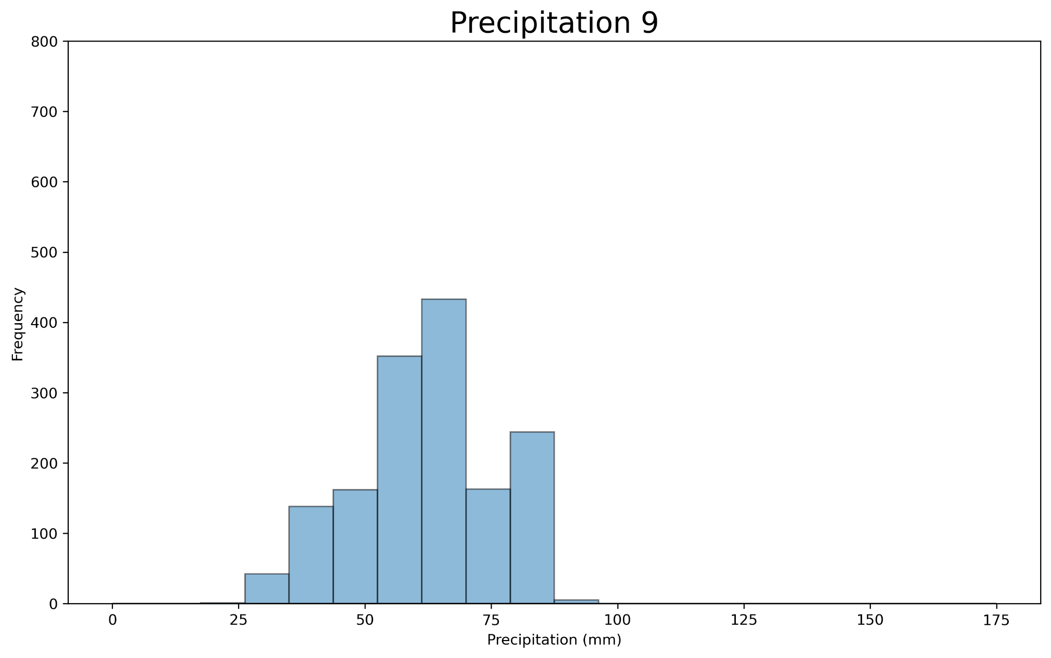
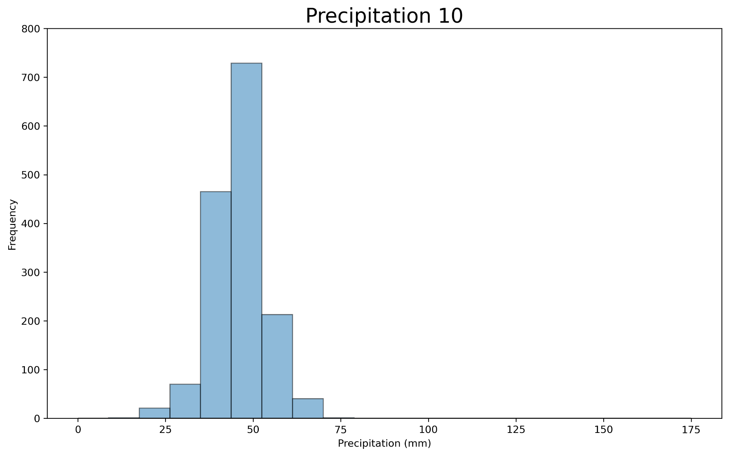
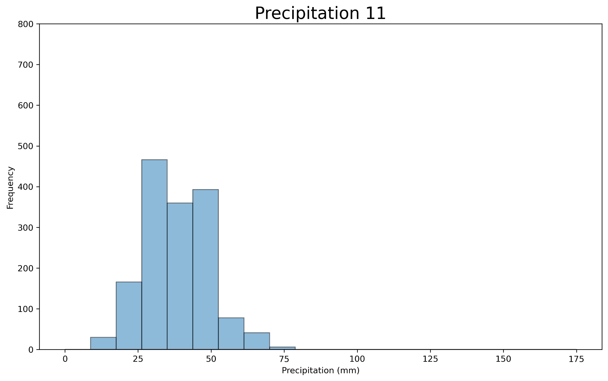
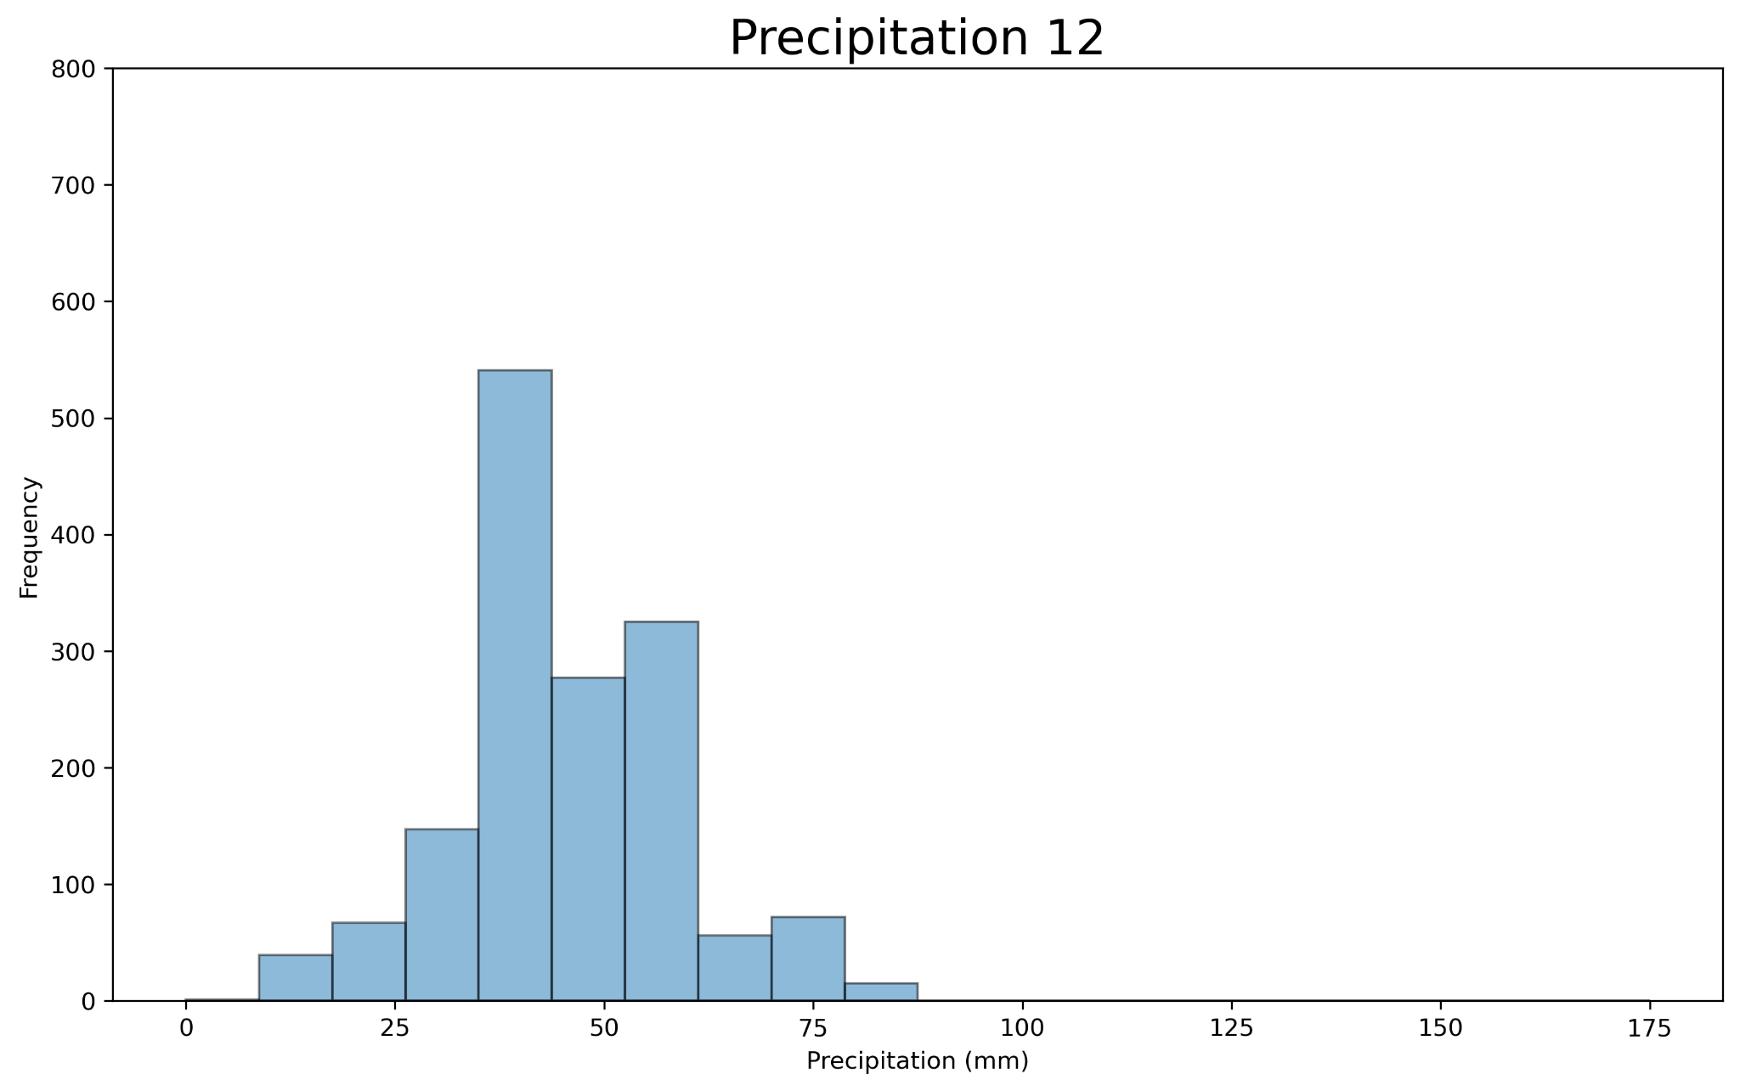
Choosing Preferences - Precipitation

Slide 18
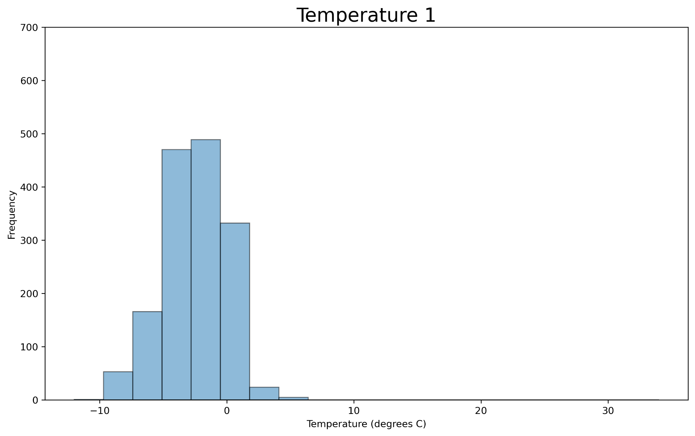
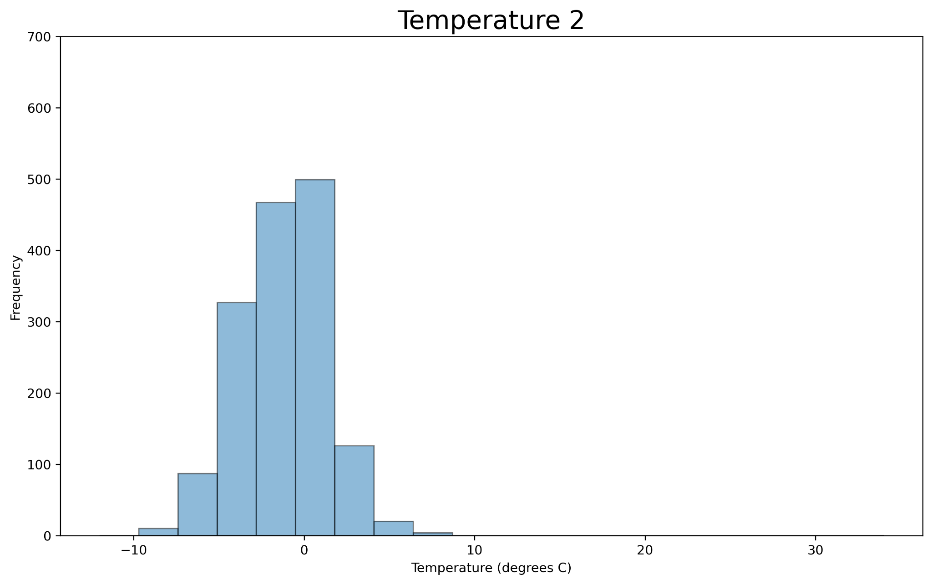
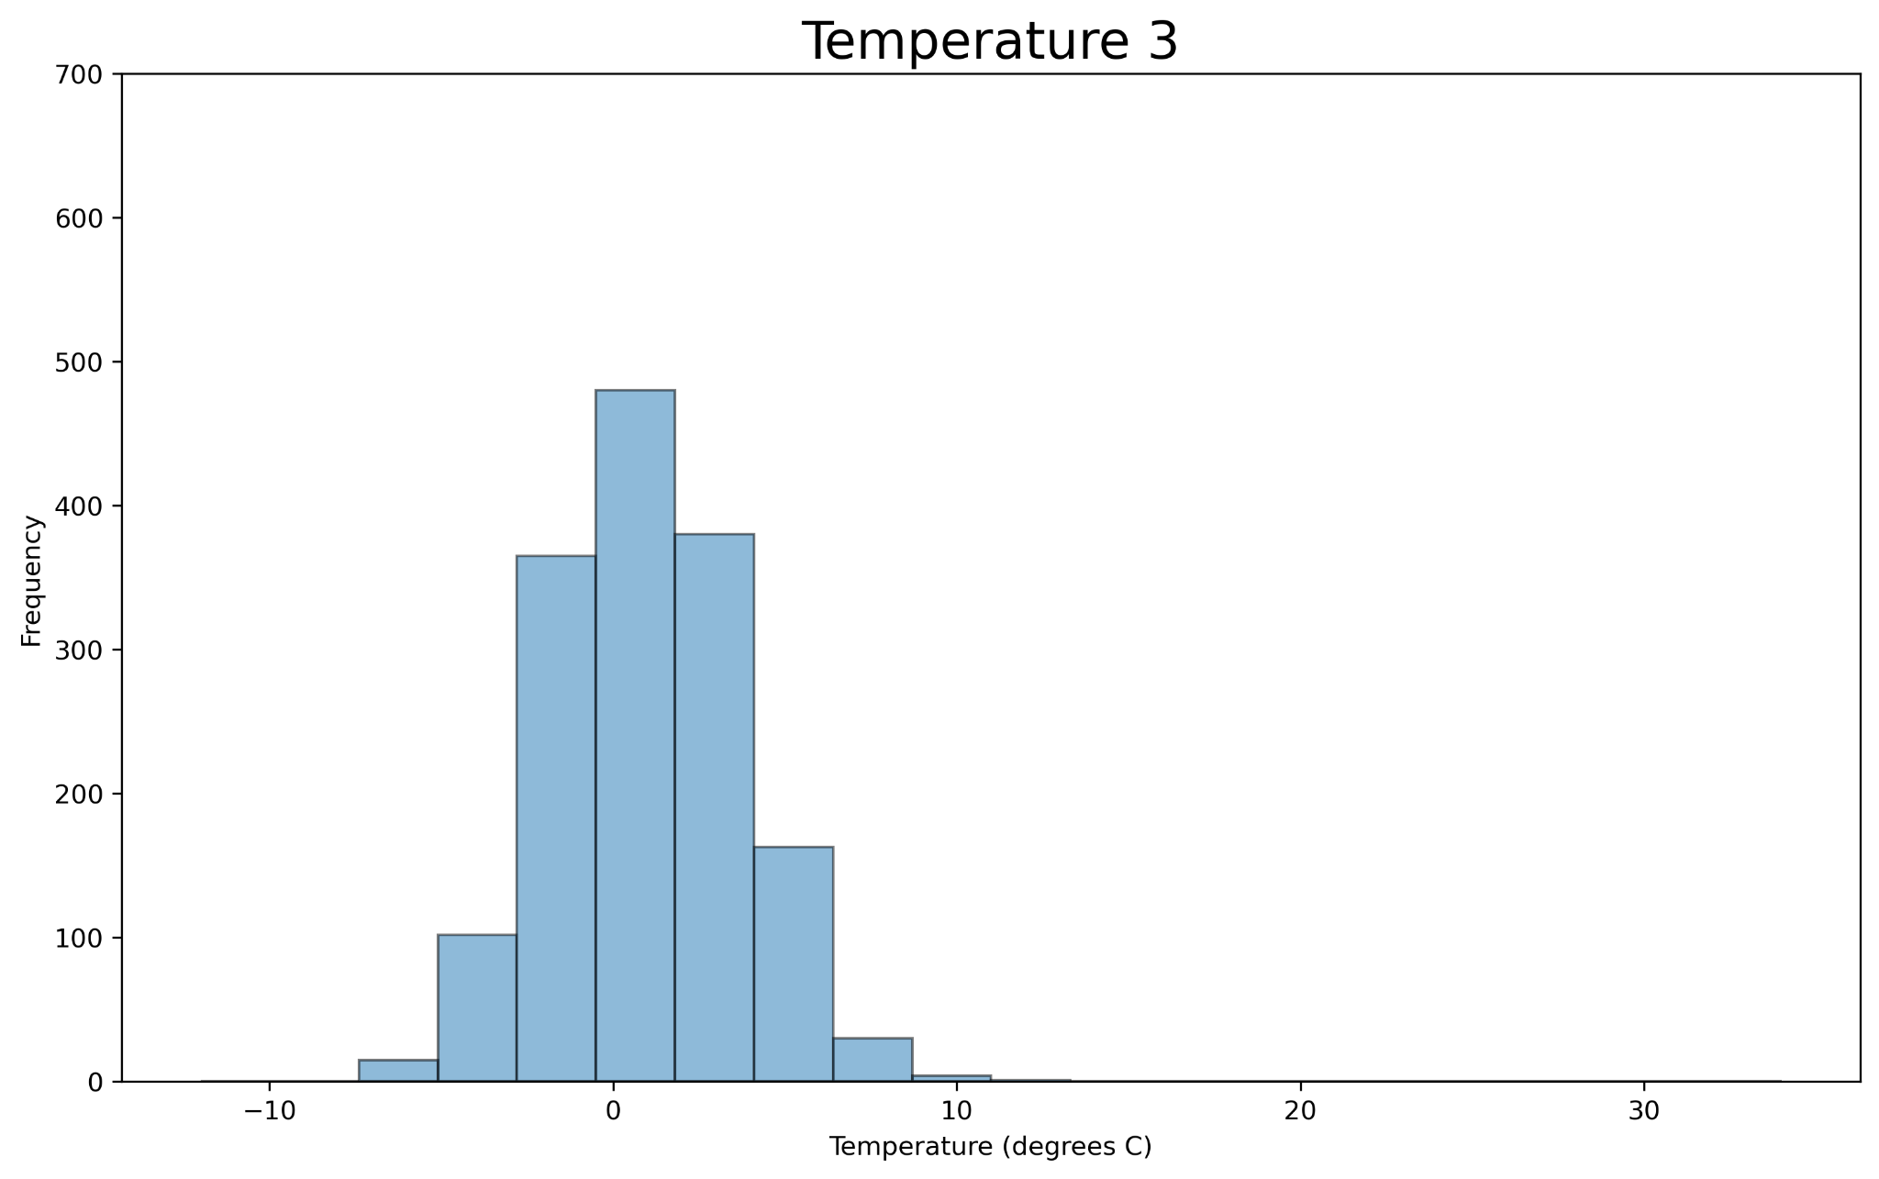
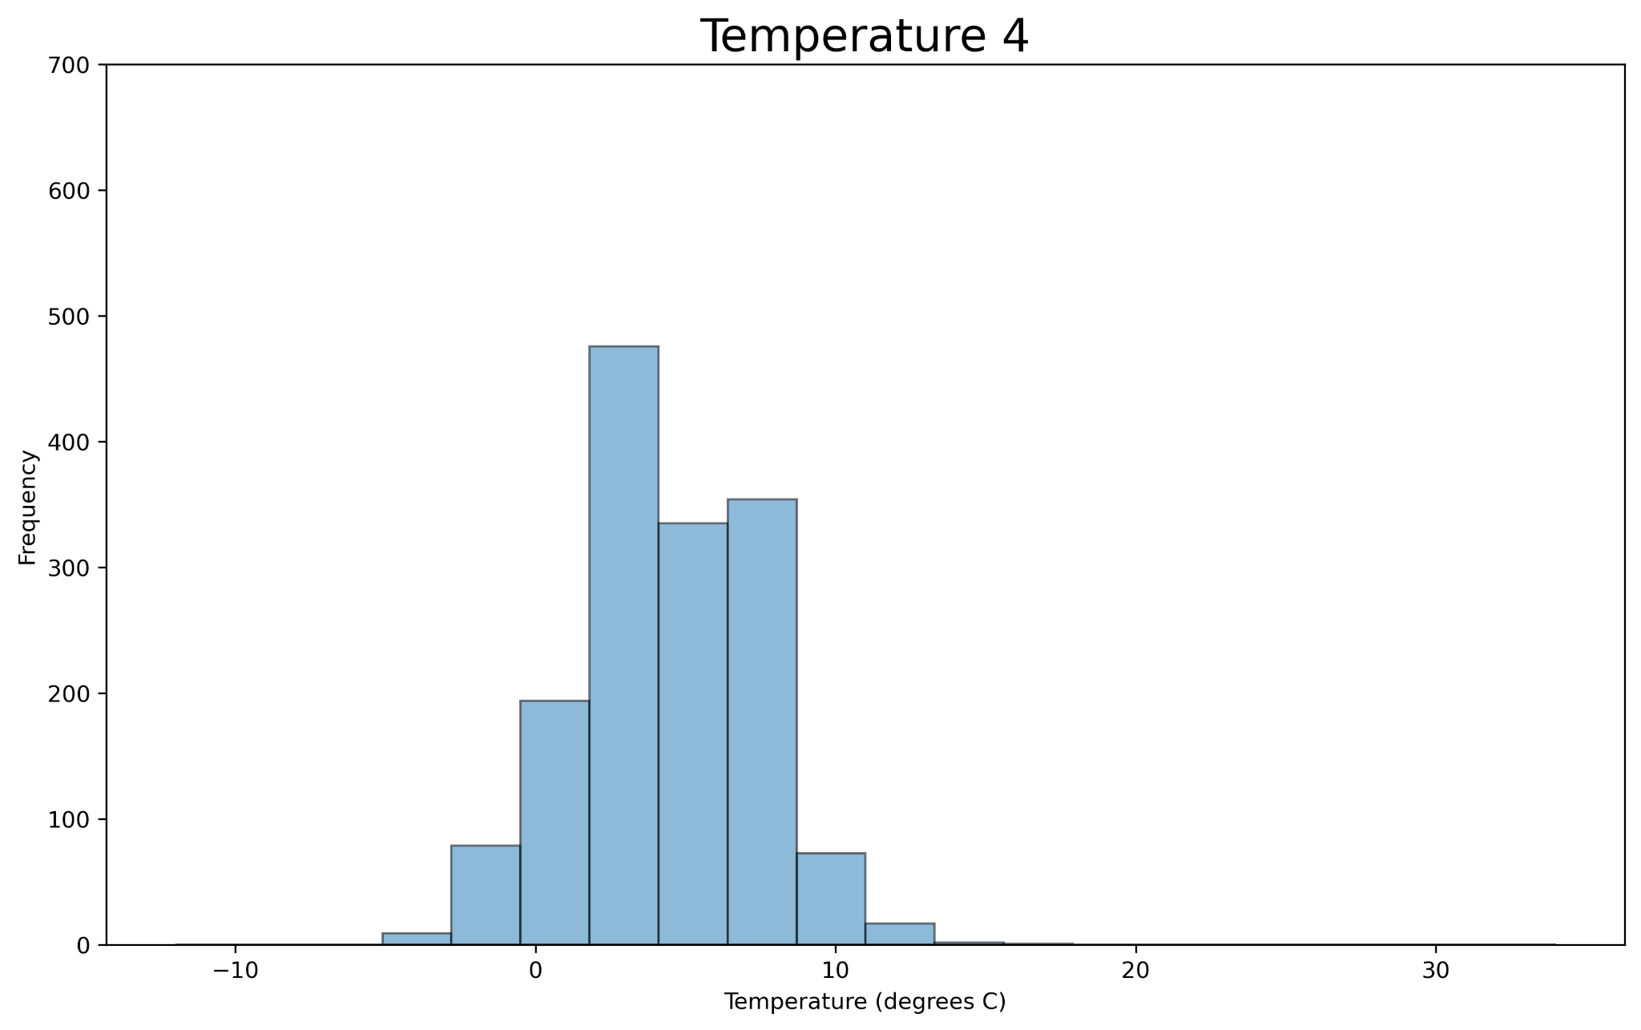
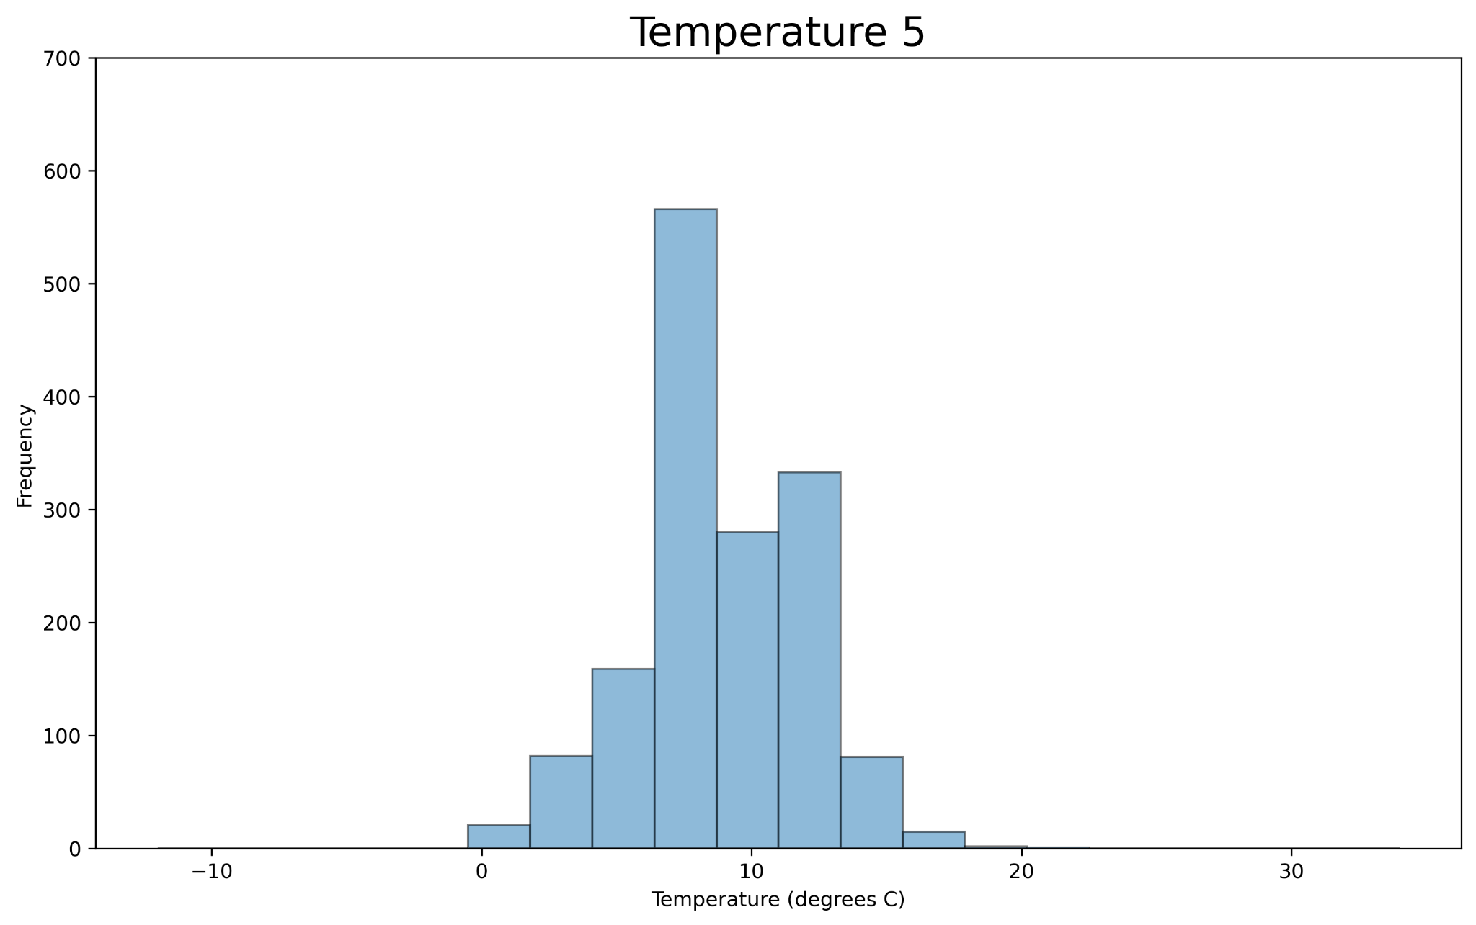
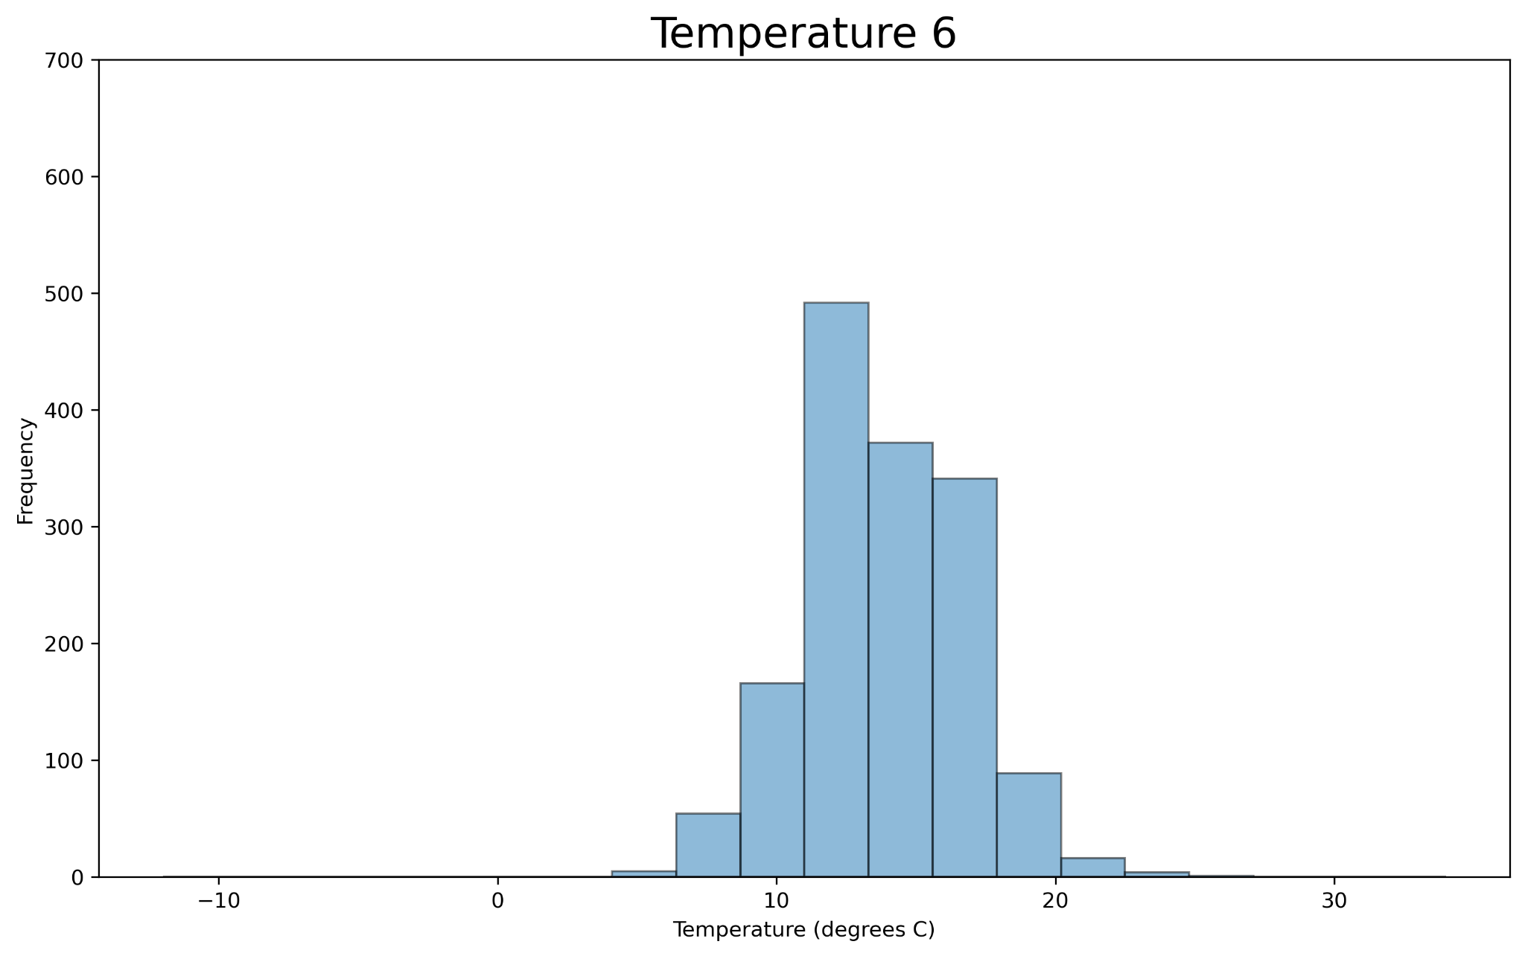
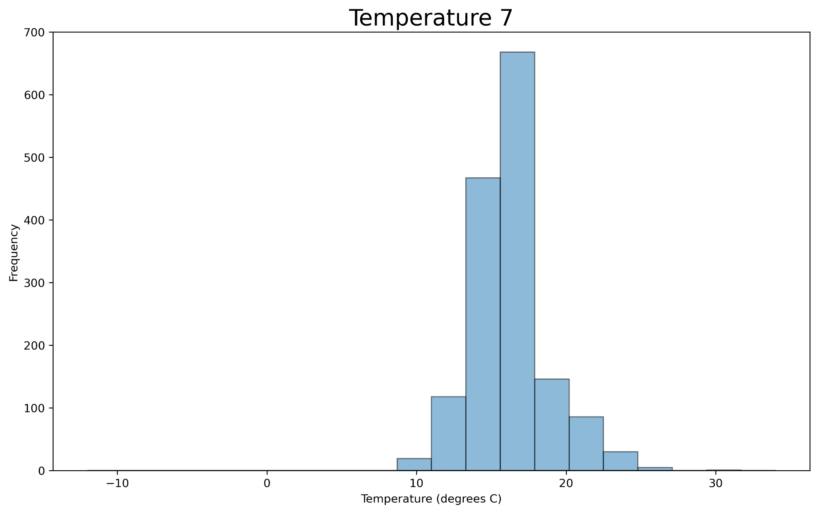
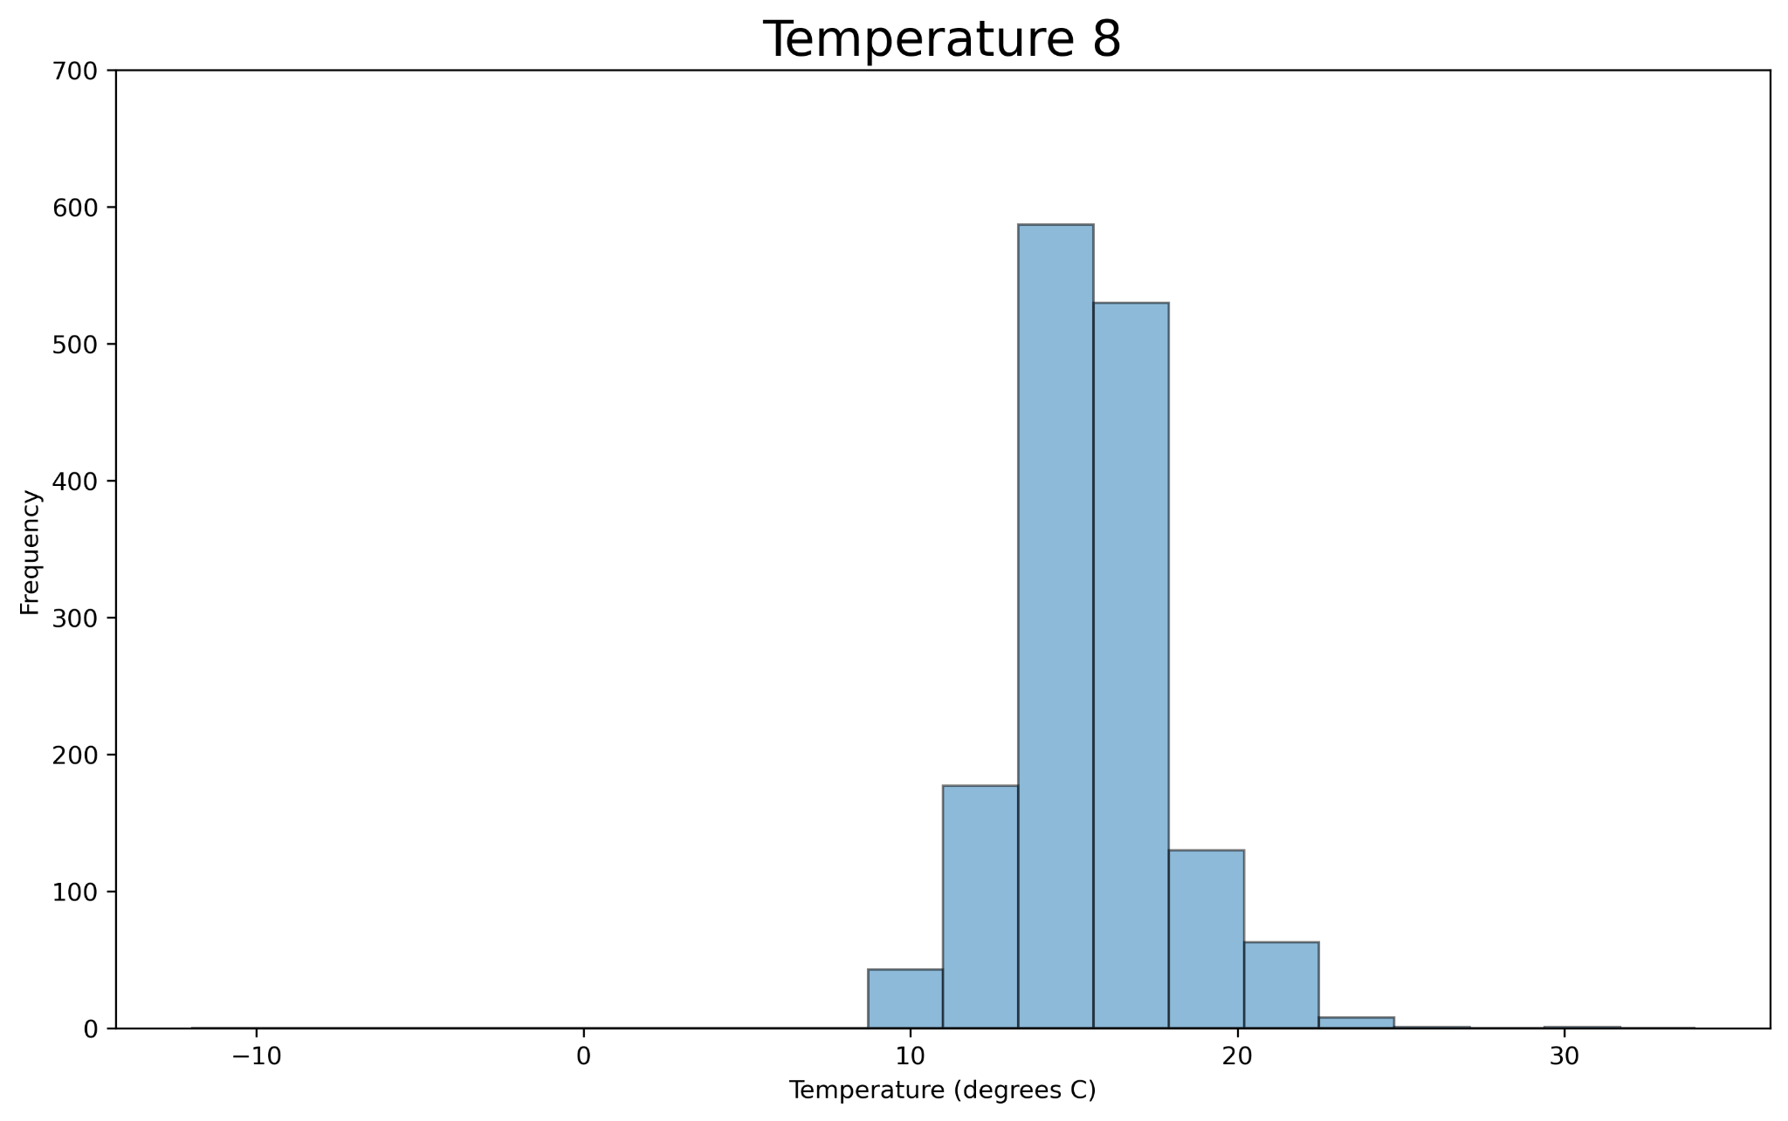
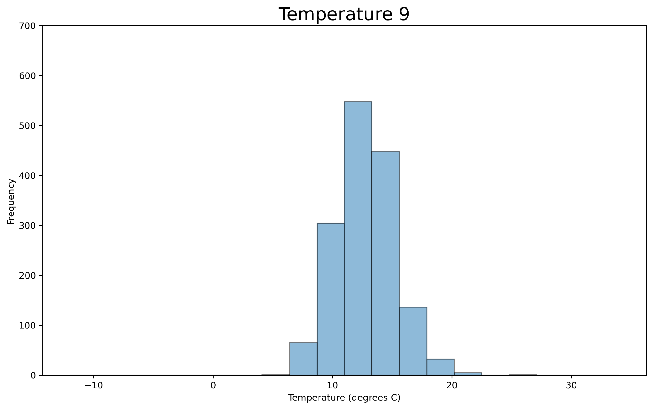
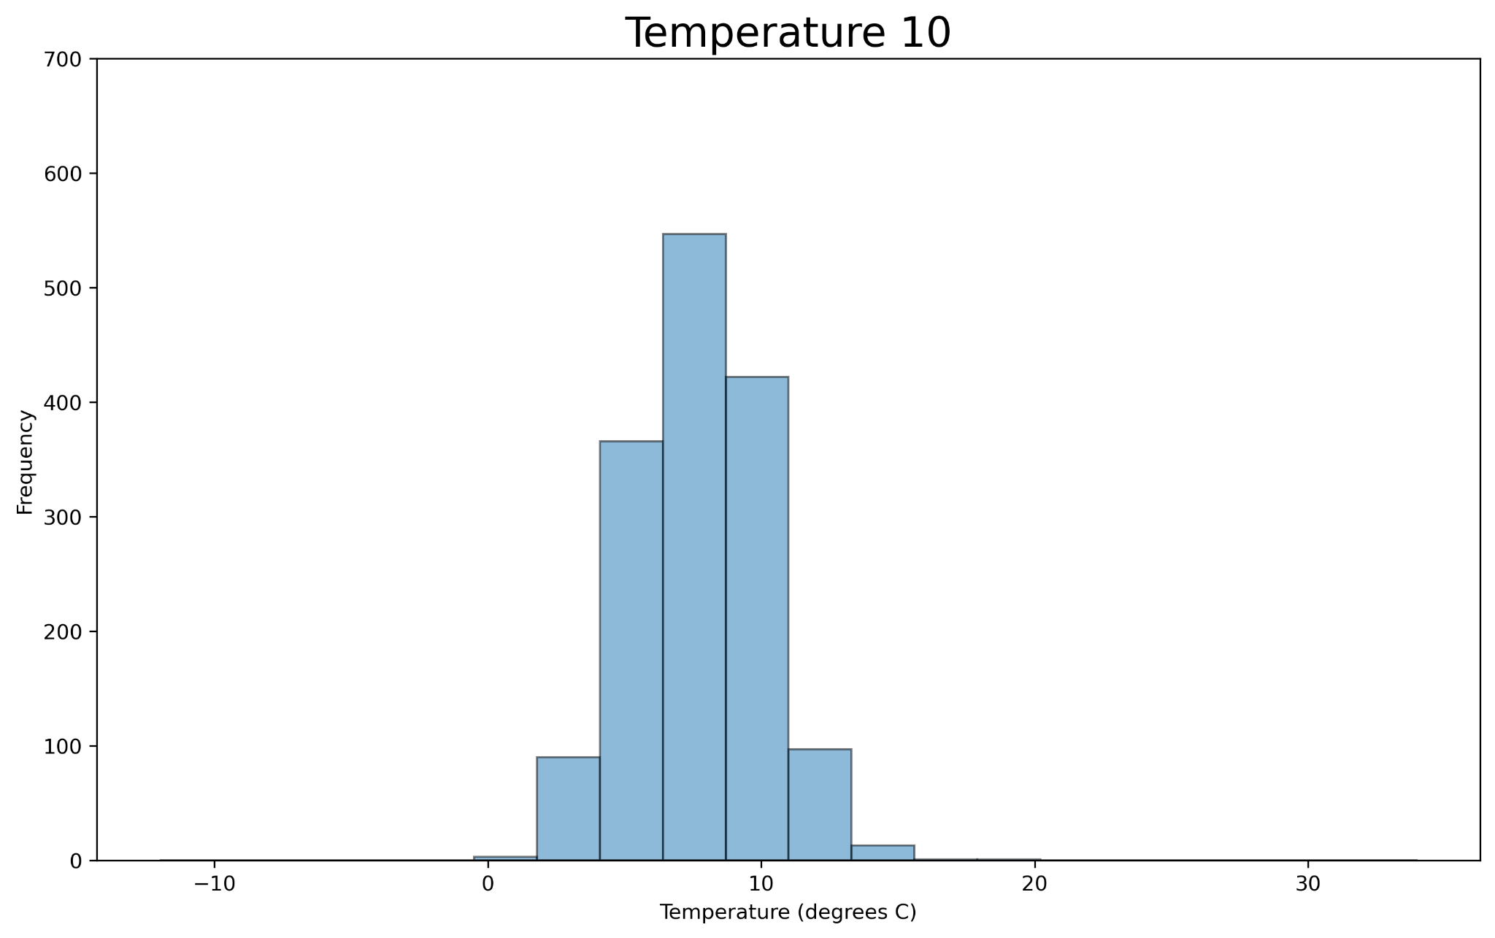
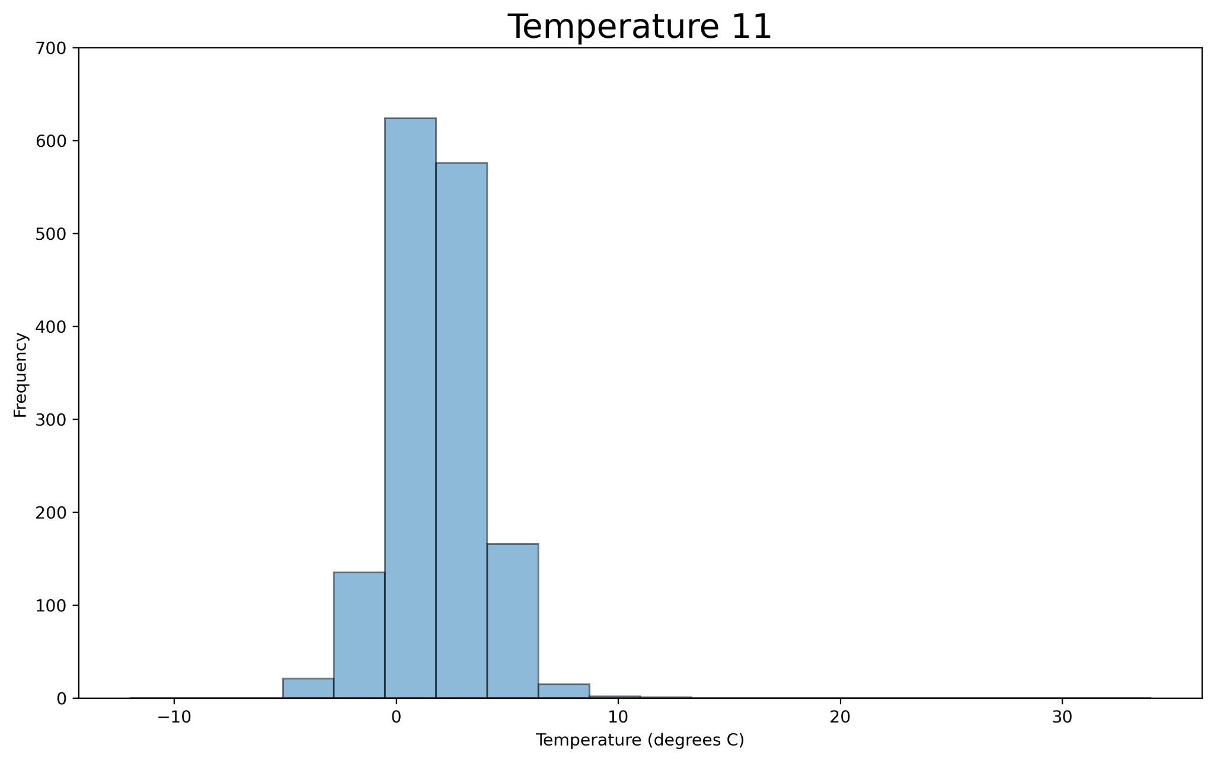
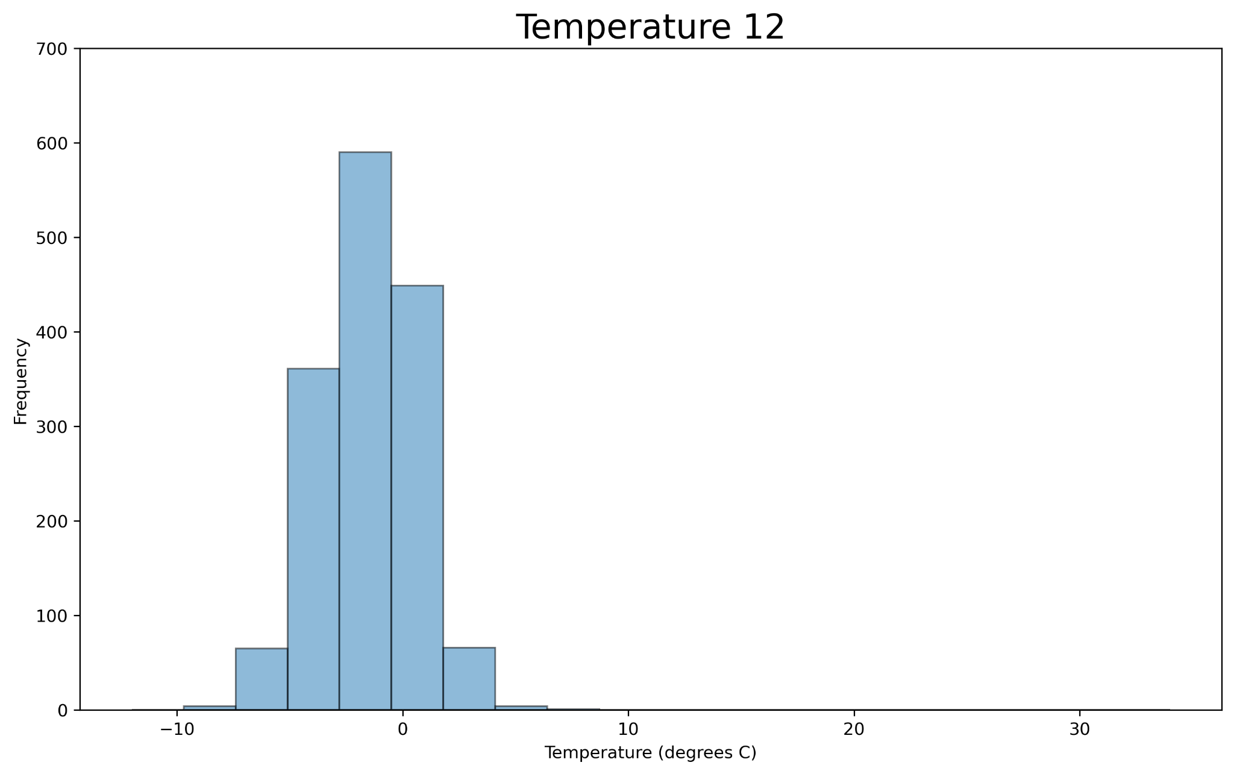
Choosing Preferences - Temperature

Slide 19
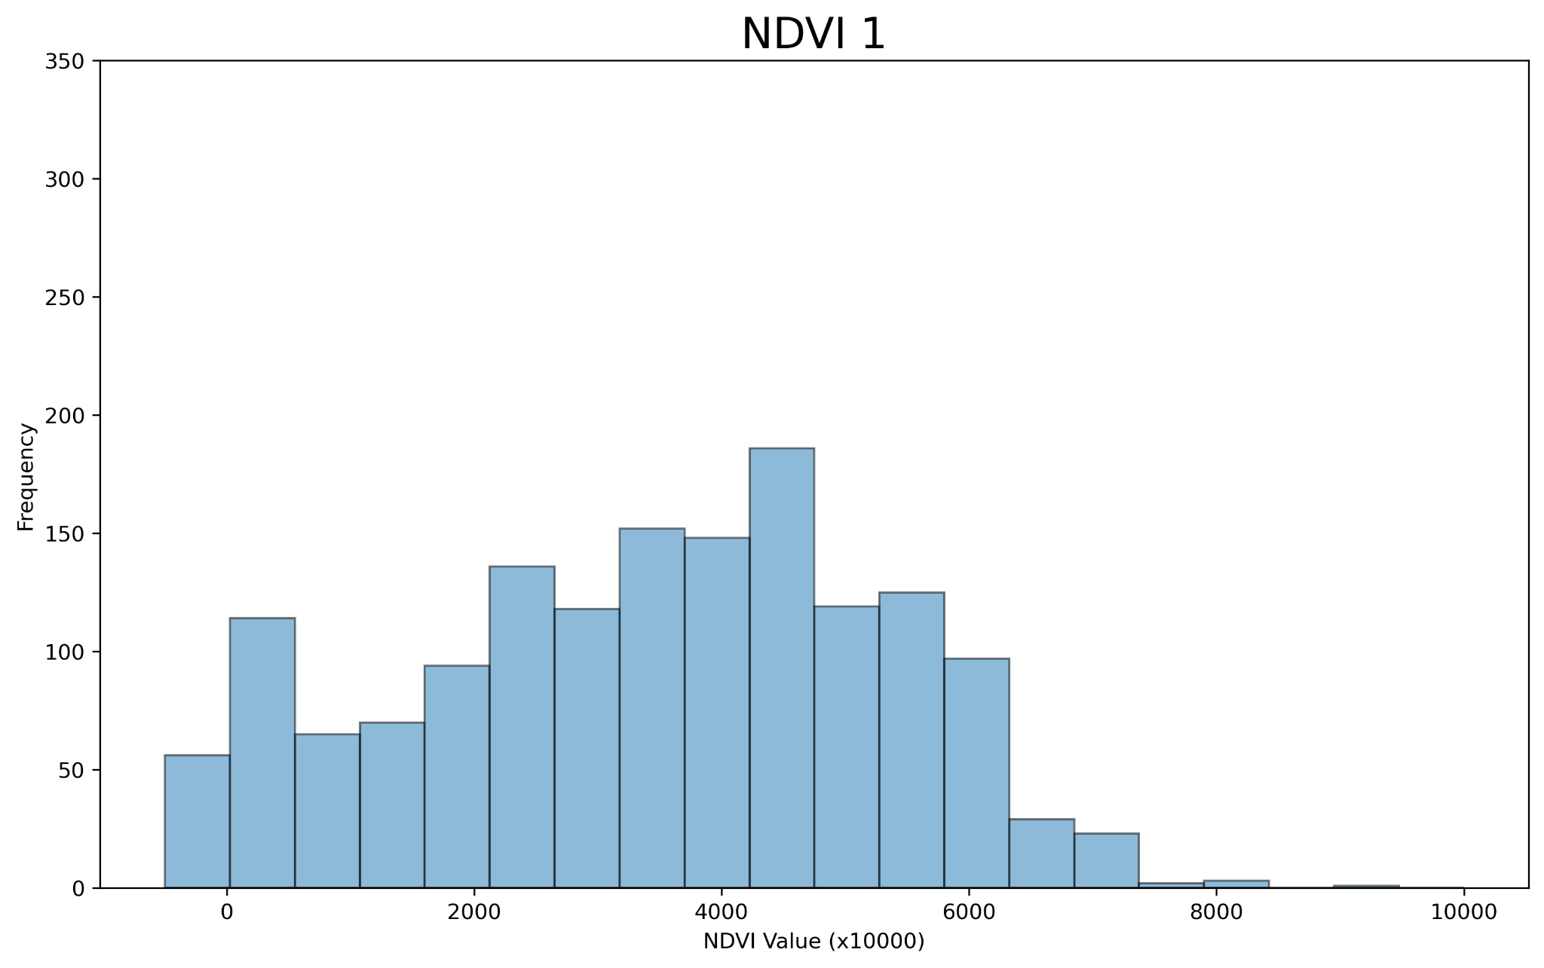











Choosing Preferences - NDVI

Slide 20

Individual Unique Preferences - Precipitation

Slide 21

Individual Unique Preferences - Temperature

Slide 22

Individual Unique Preferences - NDVI

Slide 23

Wildfires
Wildfires can cause the most severe damage to Mount Graham red squirrel populations
Damage is still varied
Source: https://cales.arizona.edu/research/redsquirrel/mgrs-data.html#

Slide 24


Wildfires
The 2017 Frye Fire was particularly destructive, killing 86% of the population
Due to a changing climate and former wildfire prevention measures, wildfires have become more prevalent recently
Forest damage from the Frye Fire (2017) -
Source: https://cales.arizona.edu/research/redsquirrel/fryefire-main.html
Spatial extent of the Frye Fire (2017)
Source: https://wildfiretoday.com/tag/frye-fire/

Slide 25
Wildfires
Specifications:
Occur roughly every 10 years (10% chance every year)
Typically occur in areas of higher NDVI values
Area of wildfires is a range and determined by current trends
Ranges from ~1000 acres to ~400000 acres, as those are the general sizes of the major wildfires within the Pinaleño Mountains
Individuals within the wildfire’s range have a mortality rate of 70%

Slide 26
Steps Forward
Add wildfire events
Find average time of extinction of the Mount Graham red squirrel as sky island shrinks
Construct final paper

Slide 27
References
Humphries, Murray M, et al. “The Determinants of Optimal Litter Size in Free-Ranging Red Squirrels.” Ecology, vol. 81, no. 10, 2000, pp. 2867–2877.
Steele, M. 1998. Mammalian Species. Pp. 1-9 in Tamiasciurus hudsonicus, Vol. 586. American Society of Mammalogists.
Koprowski, John. “Conservation Research Laboratorydr. John Koprowski - University of Arizona.” CRL: Mount Graham Red Squirrel Monitoring Program: Project Data, University of Arizona, 2019, cales.arizona.edu/research/redsquirrel/mgrs-data.html. Accessed 22 Nov. 2024.
Gabbert, Author Bill. “Frye Fire Archives.” Wildfire Today, 3 July 2017, wildfiretoday.com/tag/frye-fire/. Accessed 22 Nov. 2024.
MacDonald, Glen, et al. “Drivers of California’s Changing Wildfires: A State-of-the-Knowledge Synthesis .” International Journal of Wildland Fire, 22 May 2023, p. A-T.

Slide 28


